Slide 1
GSD 200 SOURCE HEAD
Maintenance Assembly Reference
IMPLANTER-Diffusion Department
Prepare By: SAMUEL 山姆爾 SaSPAREDOC.07

Slide 2
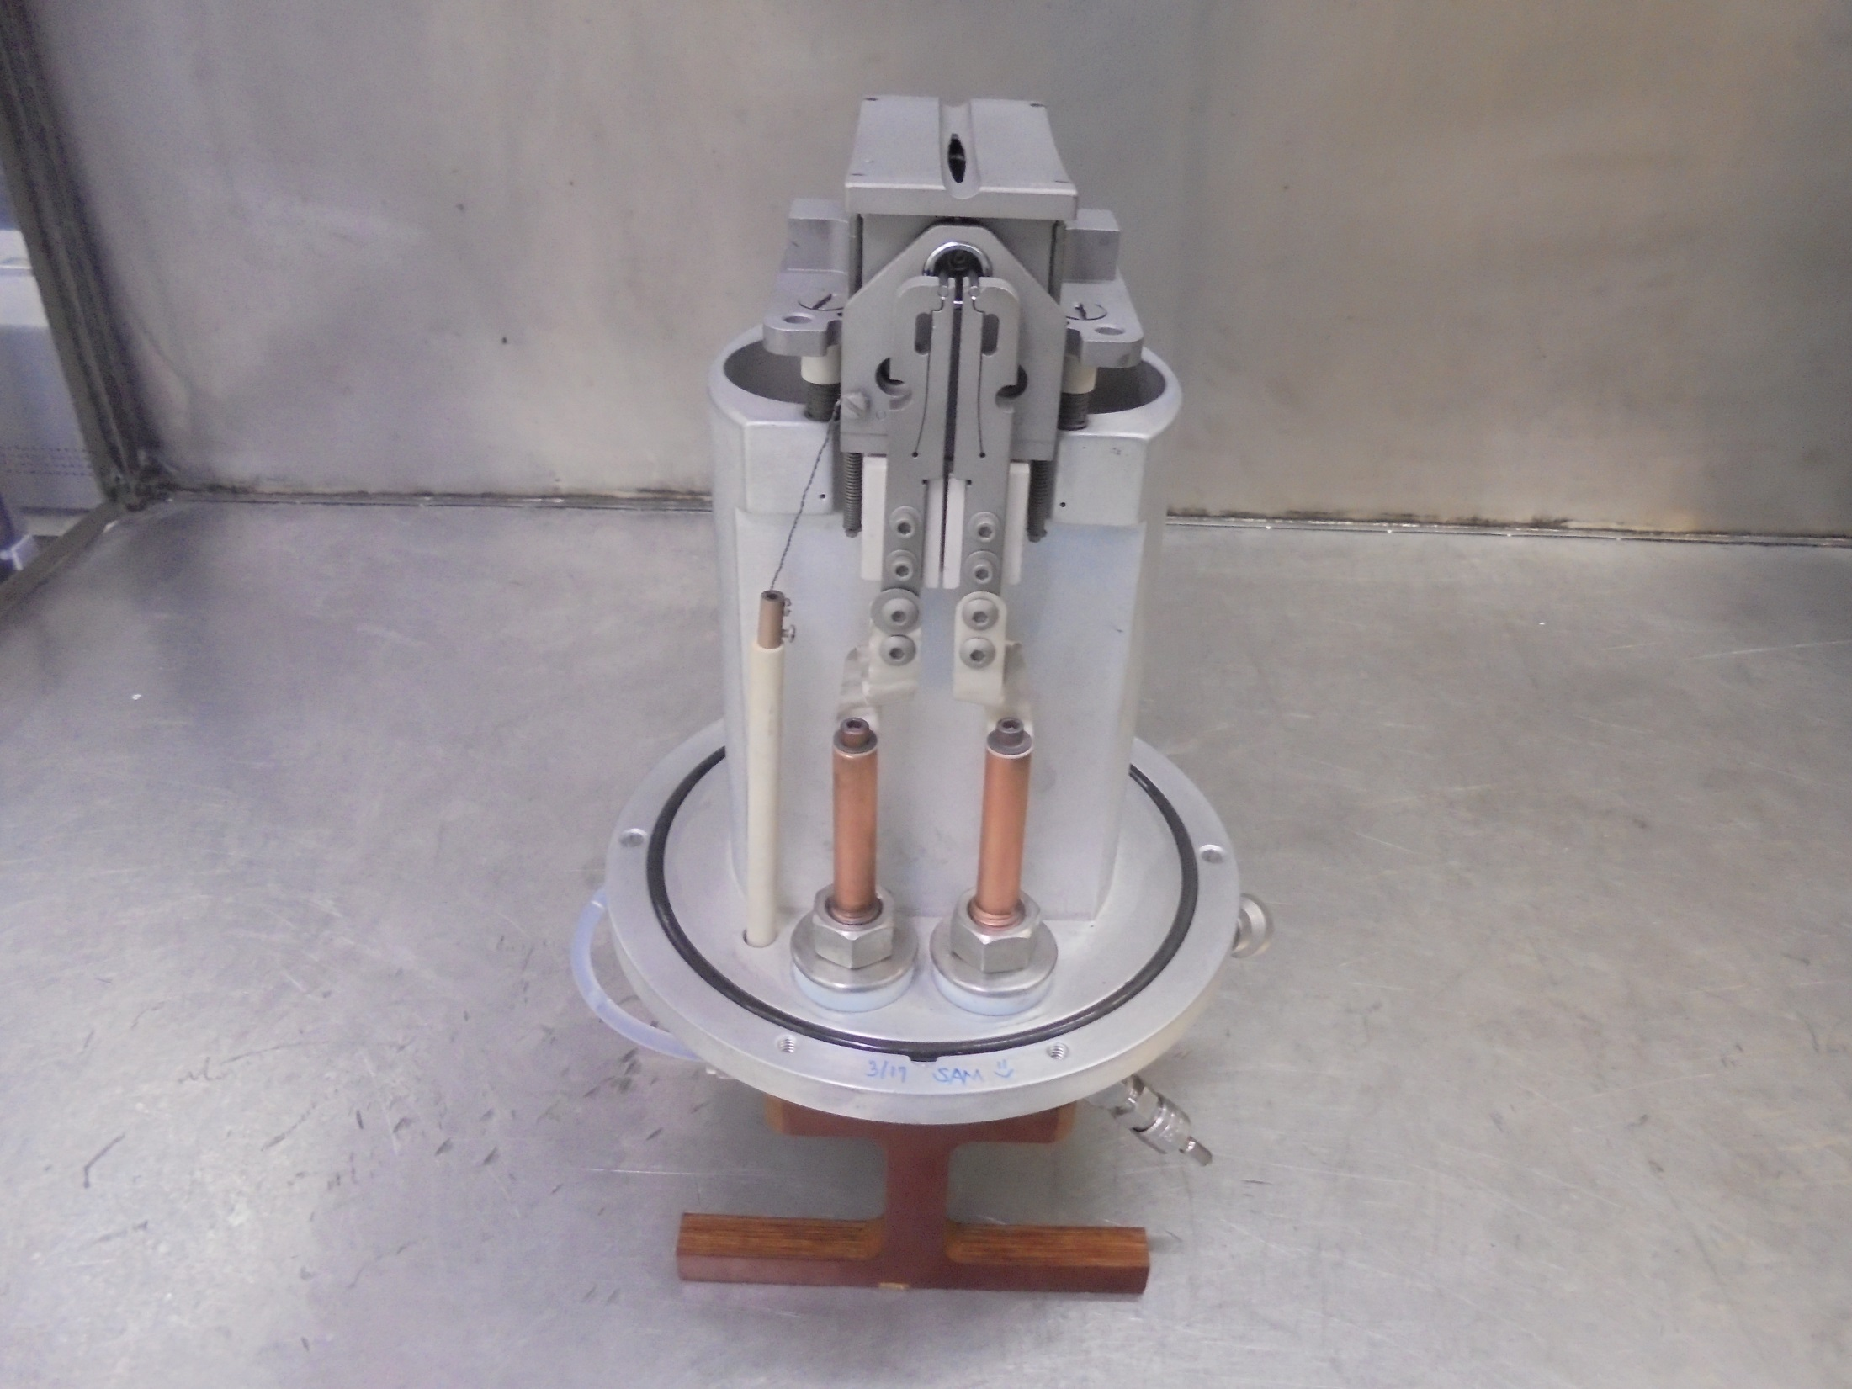
GSD 200 SOURCE HEAD

Slide 3
CONSUMABLE PARTS

Slide 4
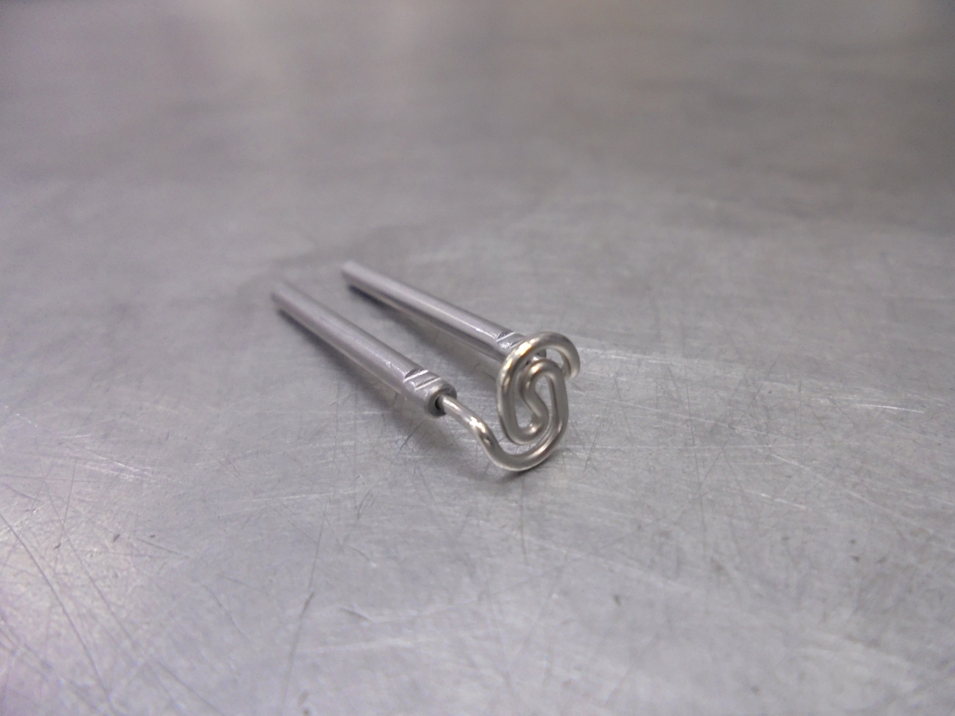
ELS FILAMENT

Slide 5
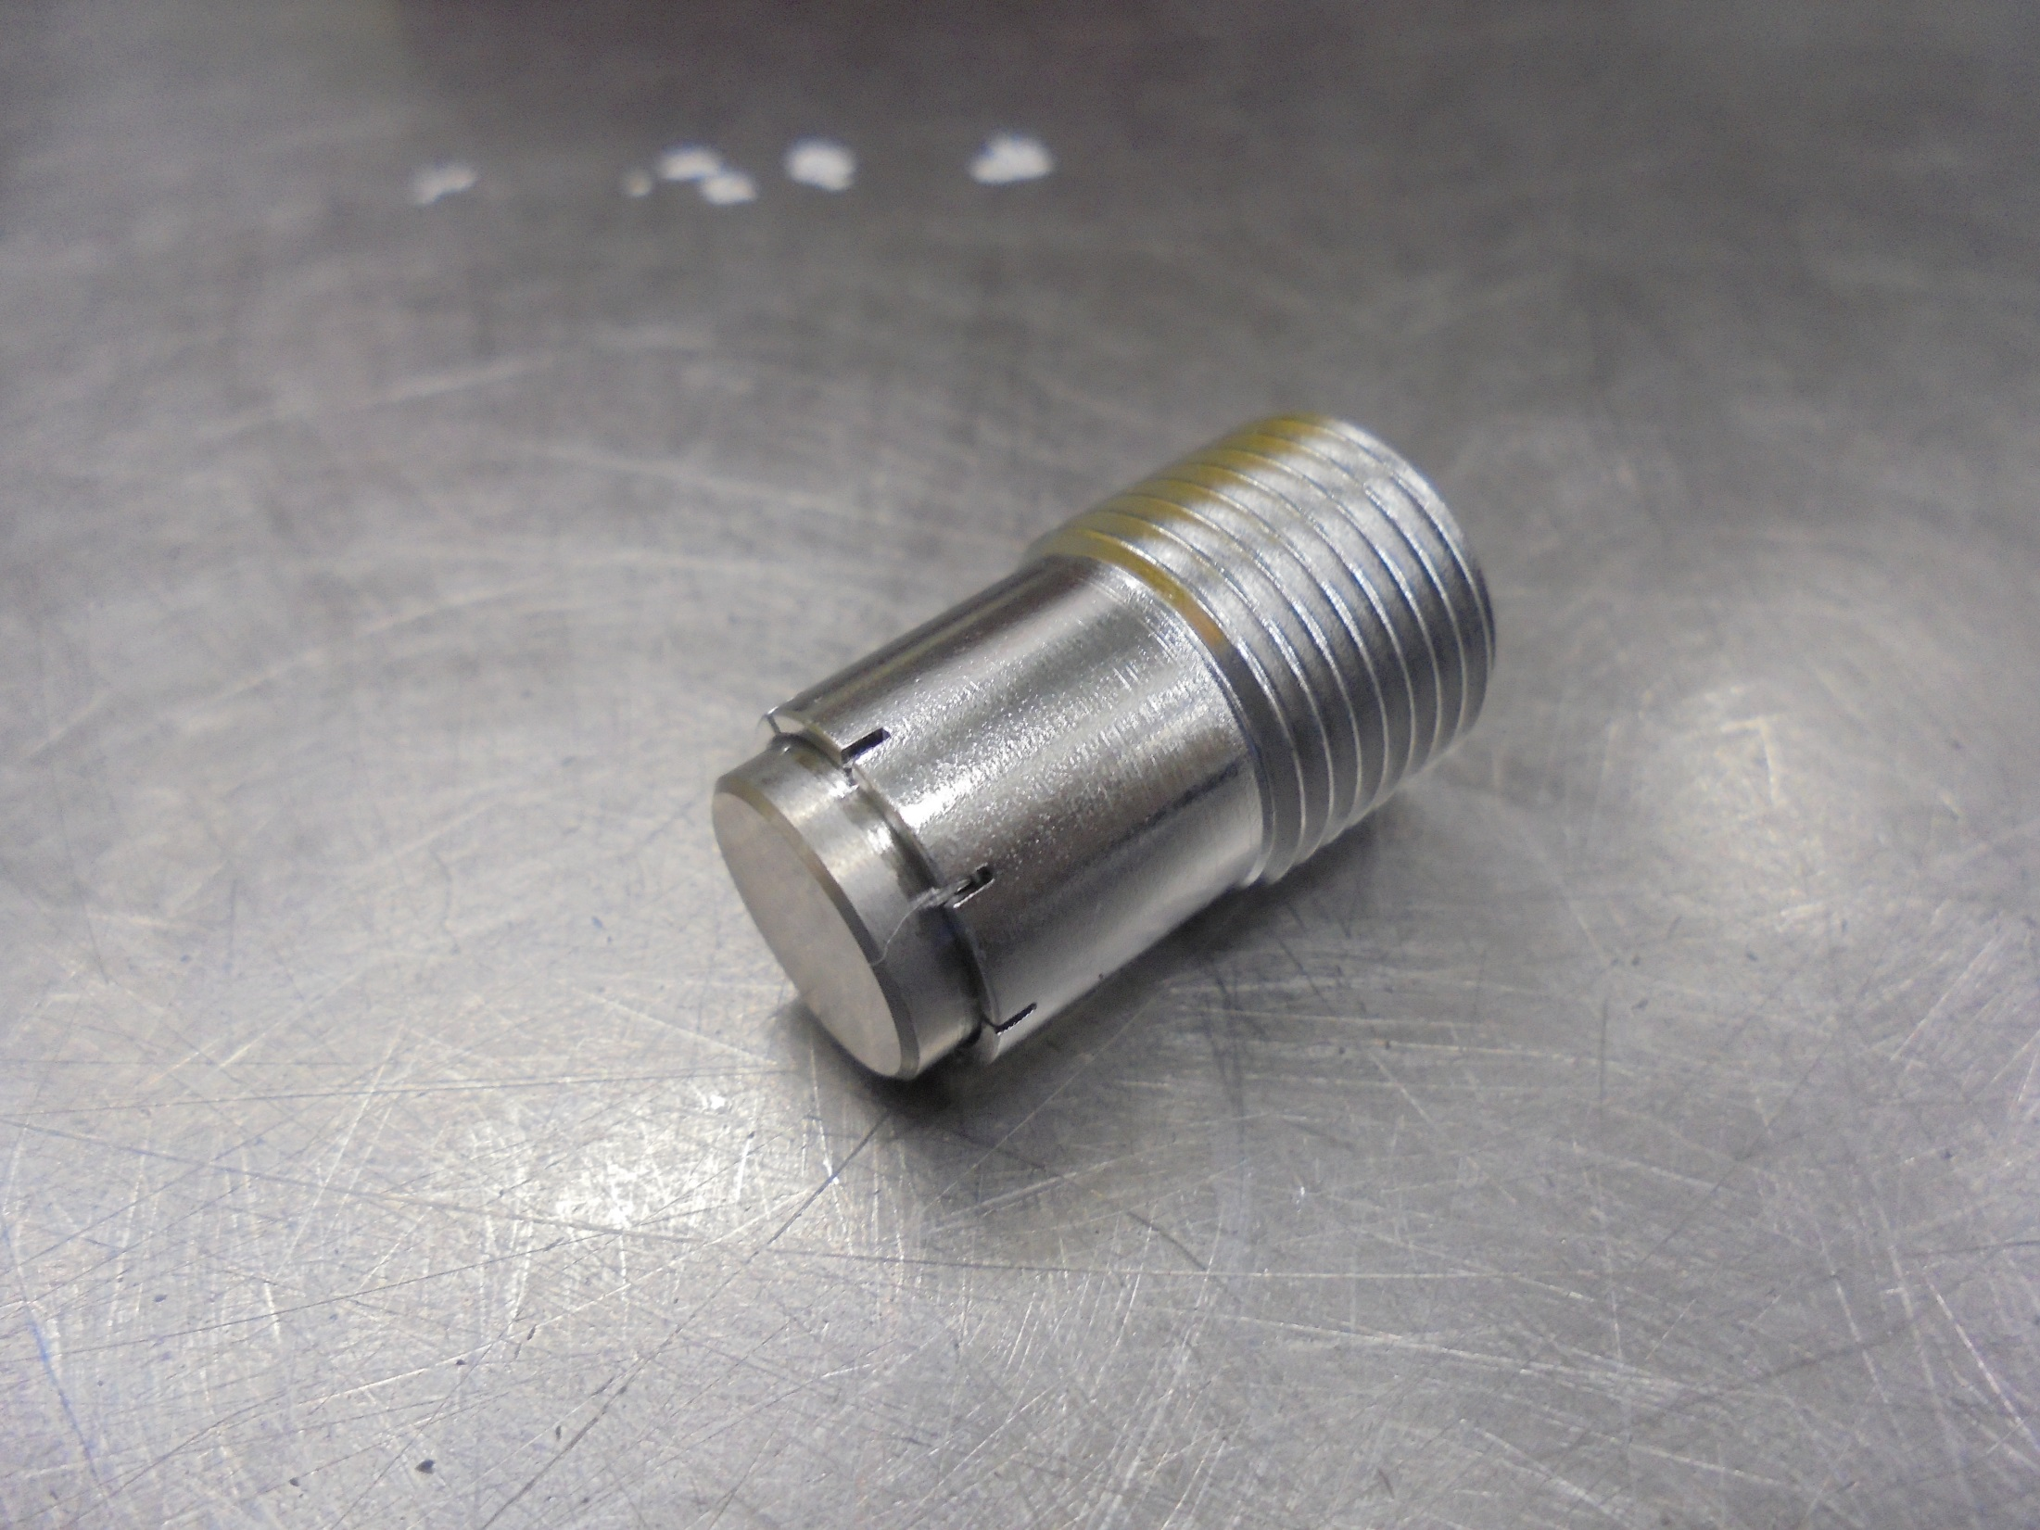
CATHODE

Slide 6
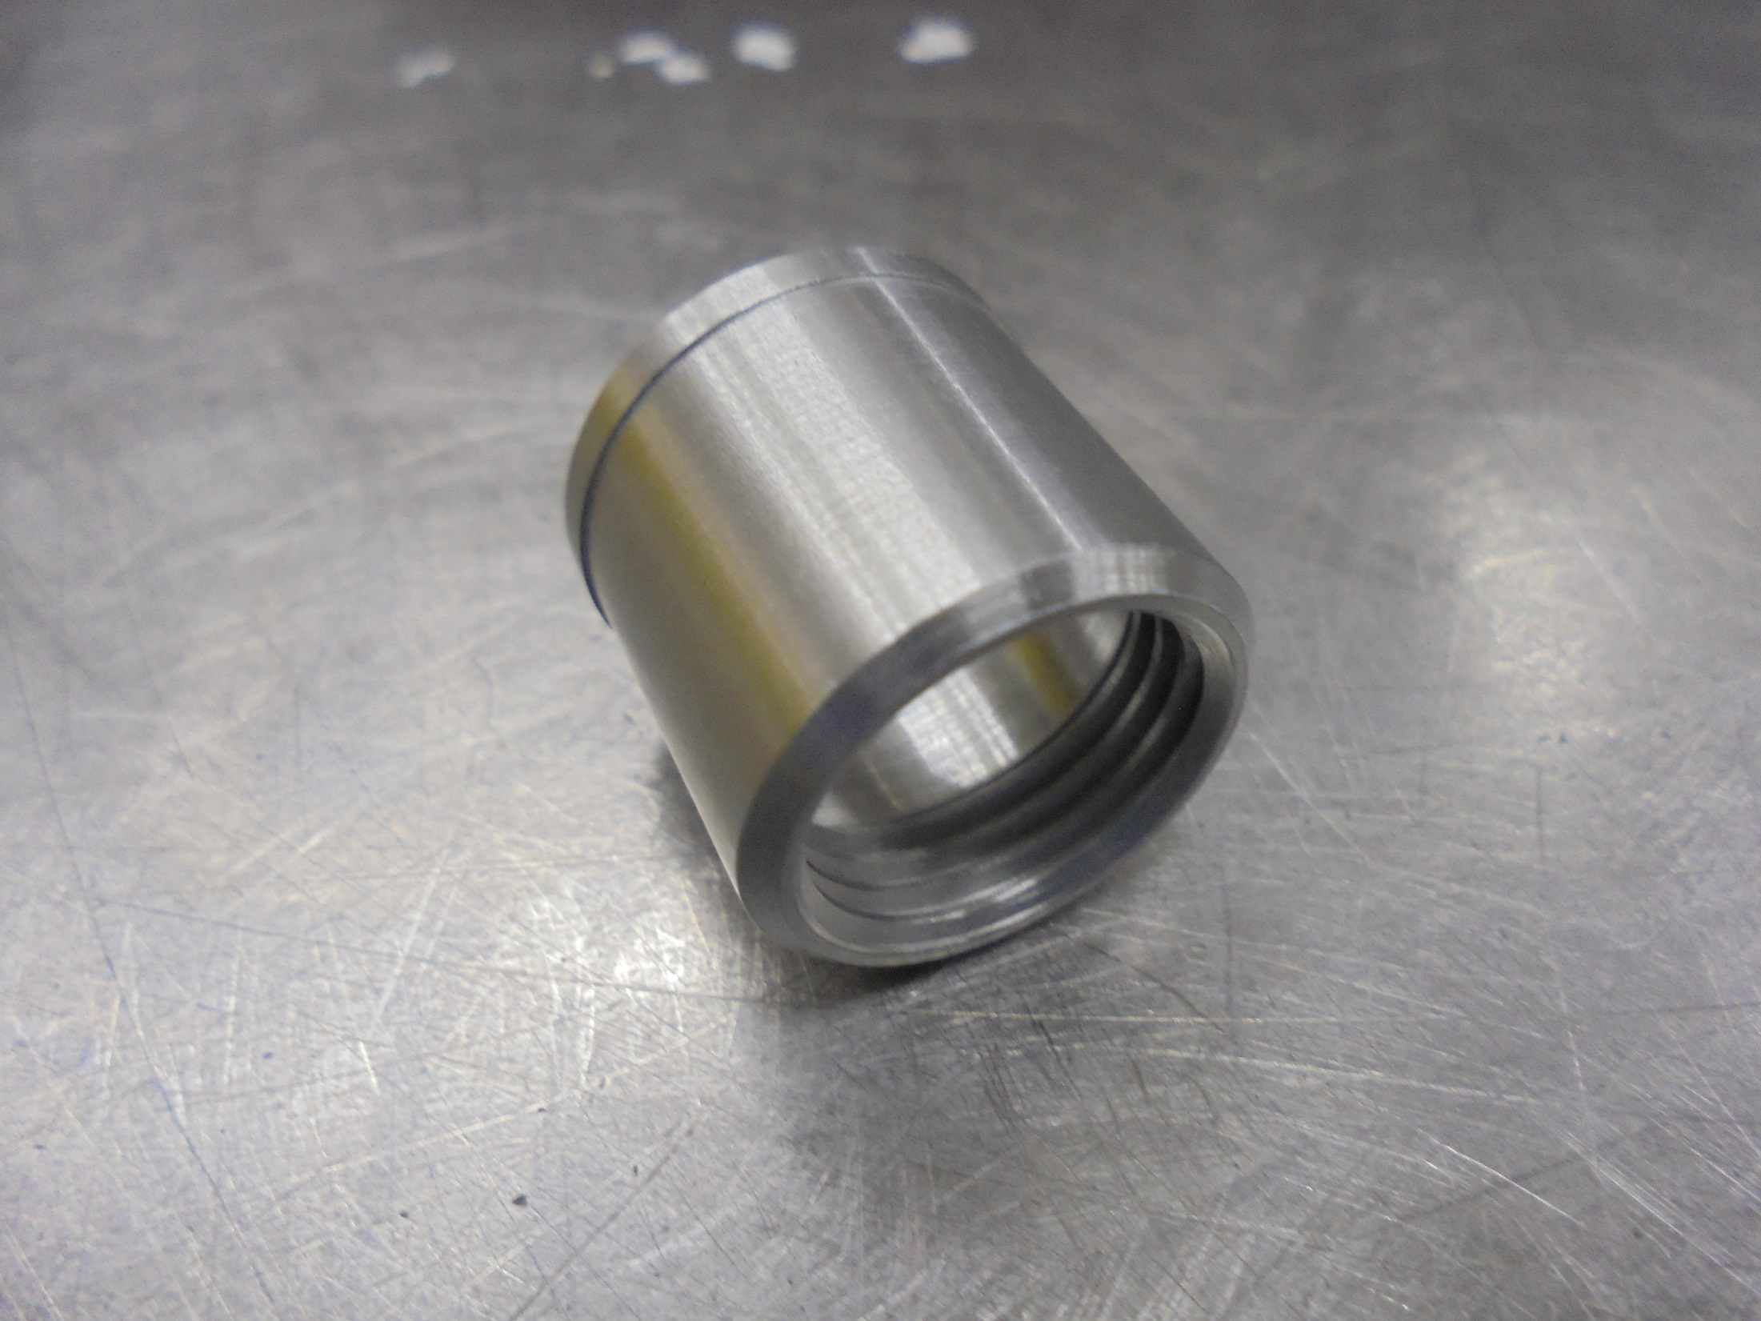
CATHODE REPELLER

Slide 7
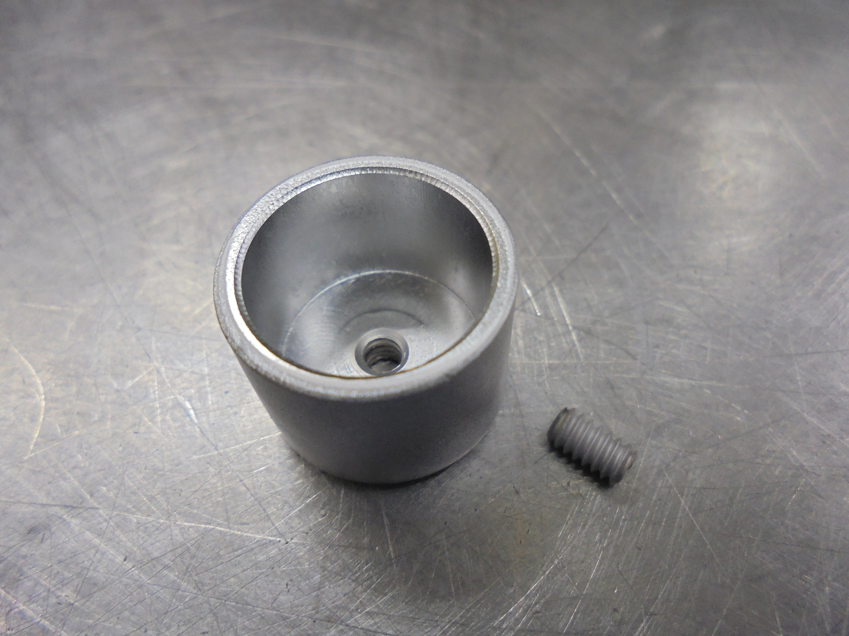
ELS REPELLER
REPELLER SET SCREW

Slide 8
ASSEMBLY

Slide 9
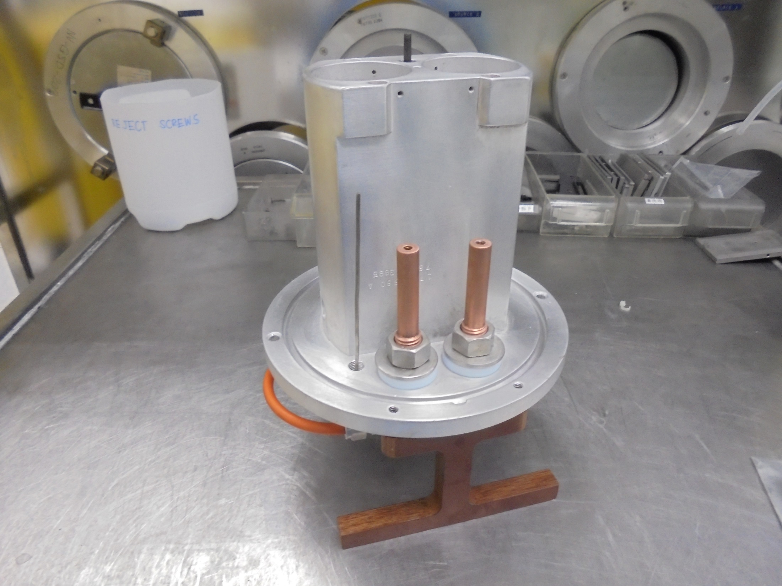
SOURCE BODY

Slide 10
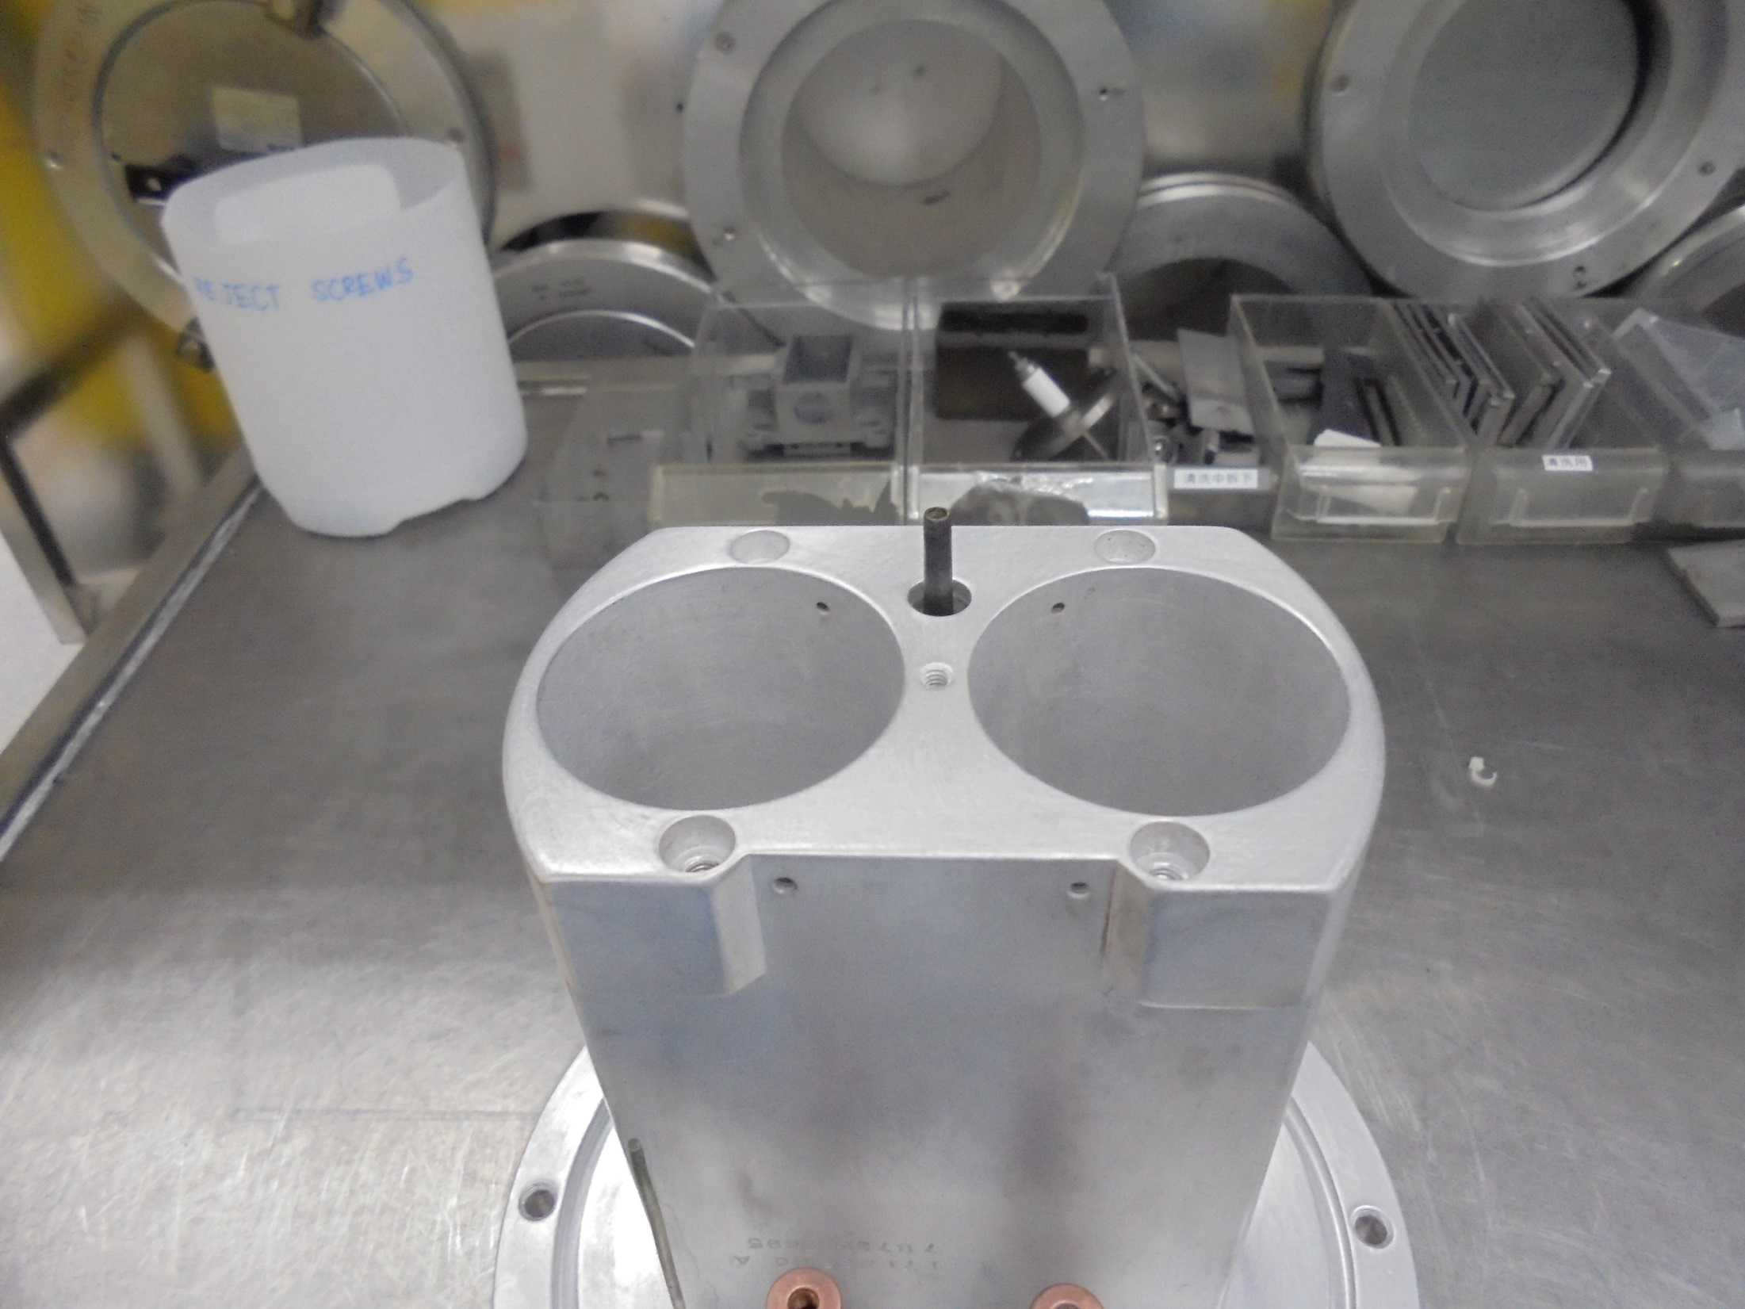
TOP MOUNTING STAGE

Slide 11
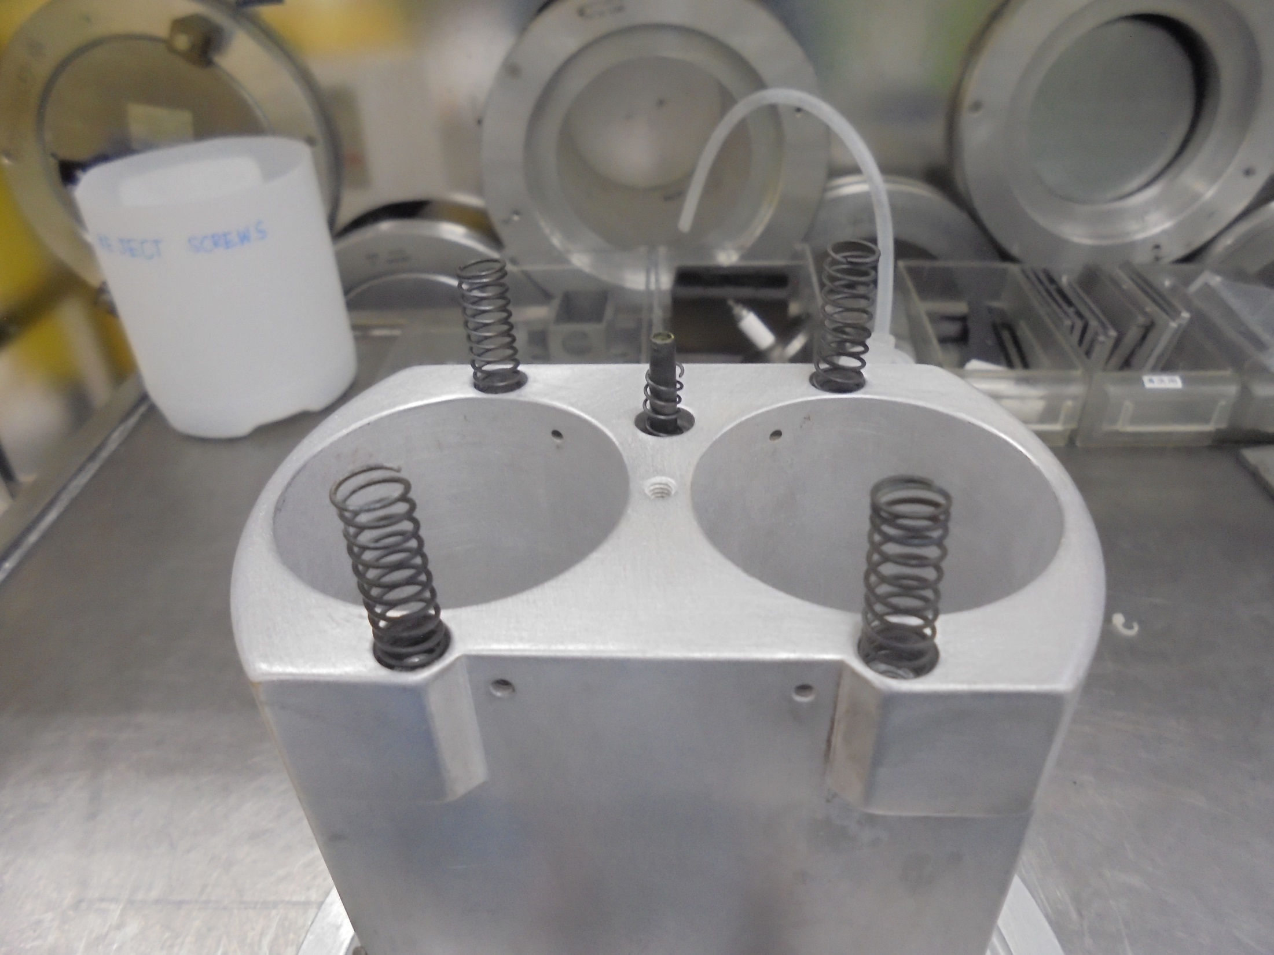
SHOULDER SPRINGS
GAS FEED-THRU
BALL JOINT SPRING

Slide 12
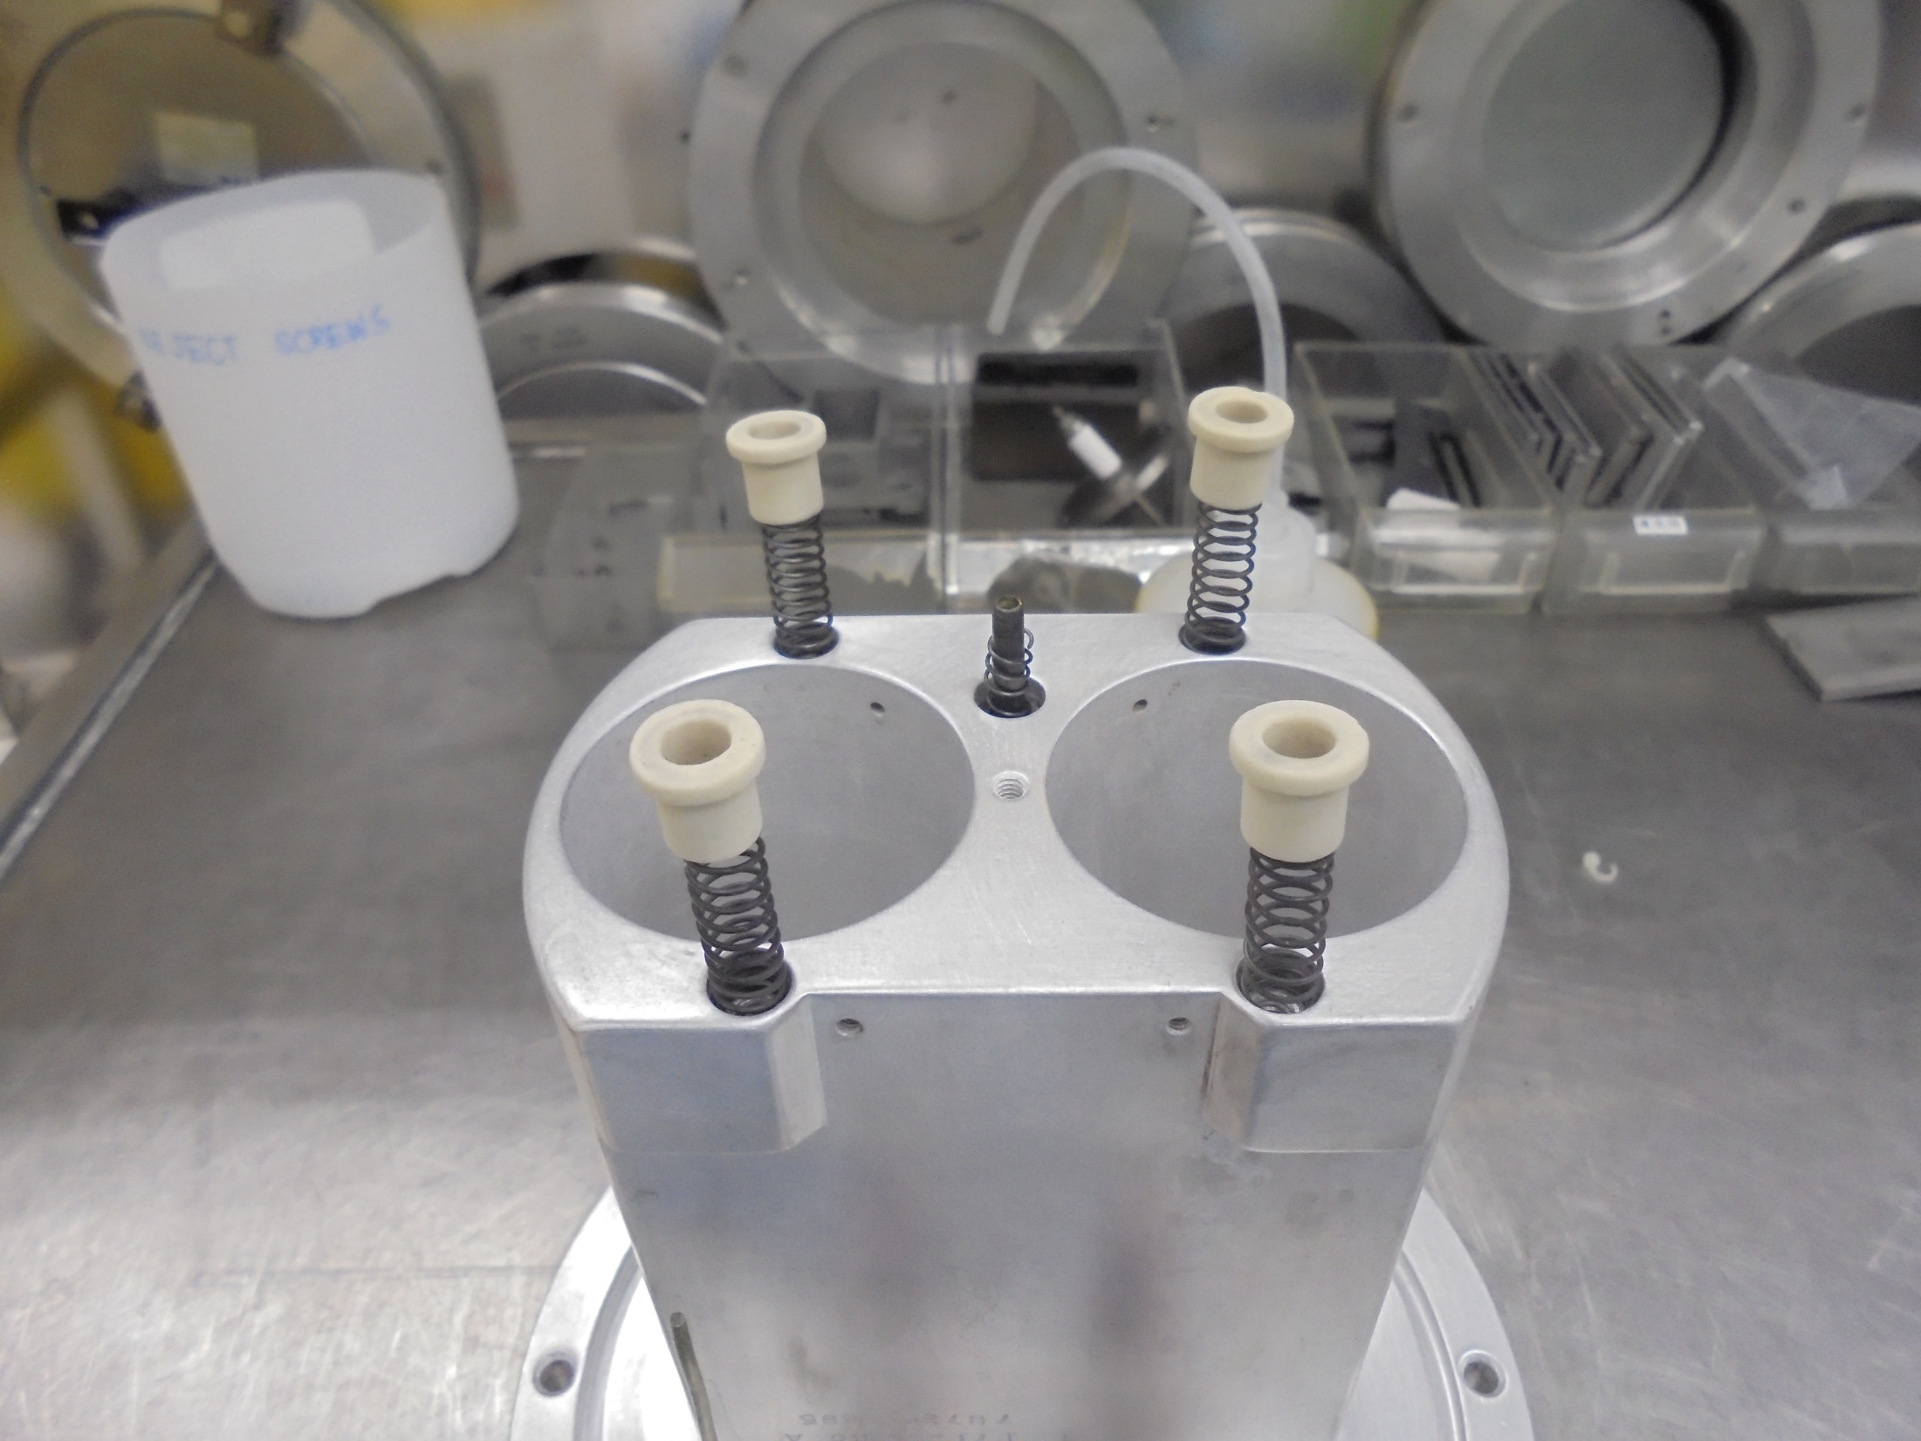
SHOULDER SCREW SPACER

Slide 13
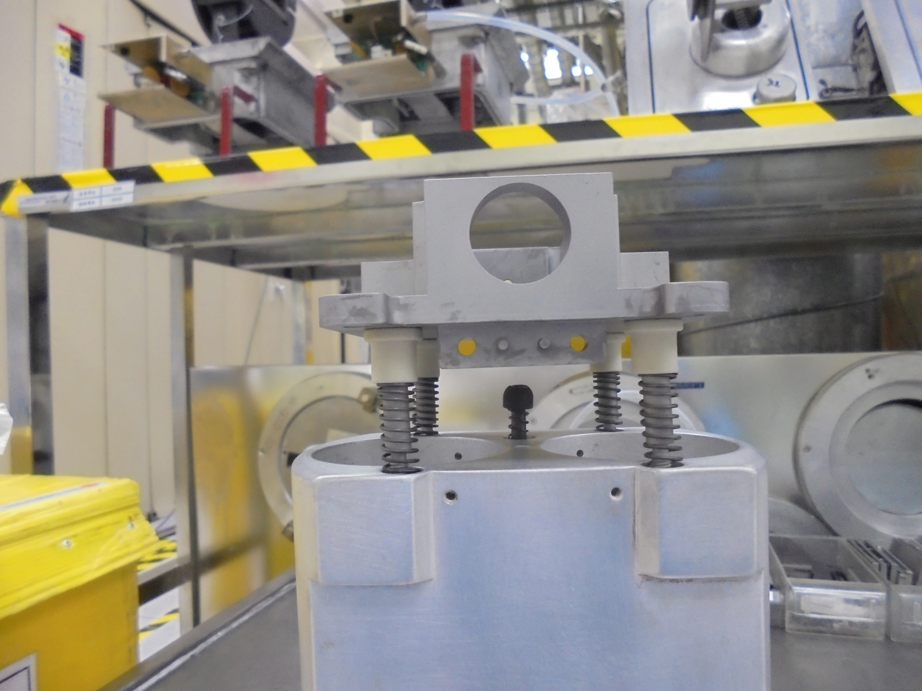
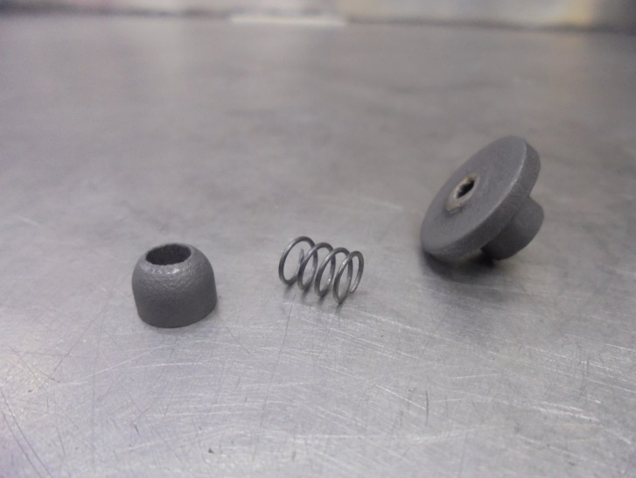
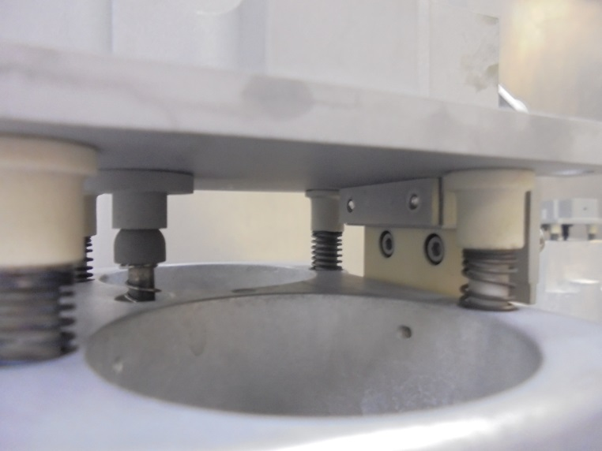
BALL.SPRING.SKT JOINT

Slide 14
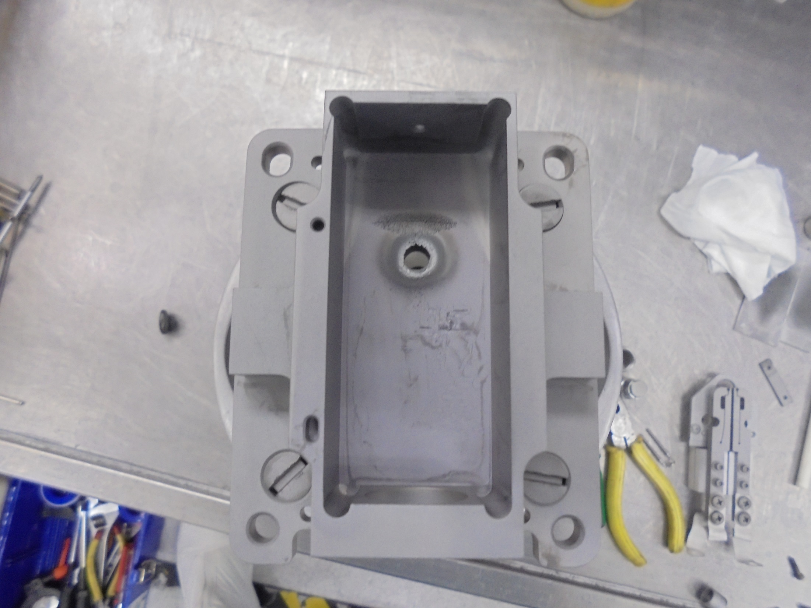
TIGHTEN THE MOUNTING SCREWS

Slide 15
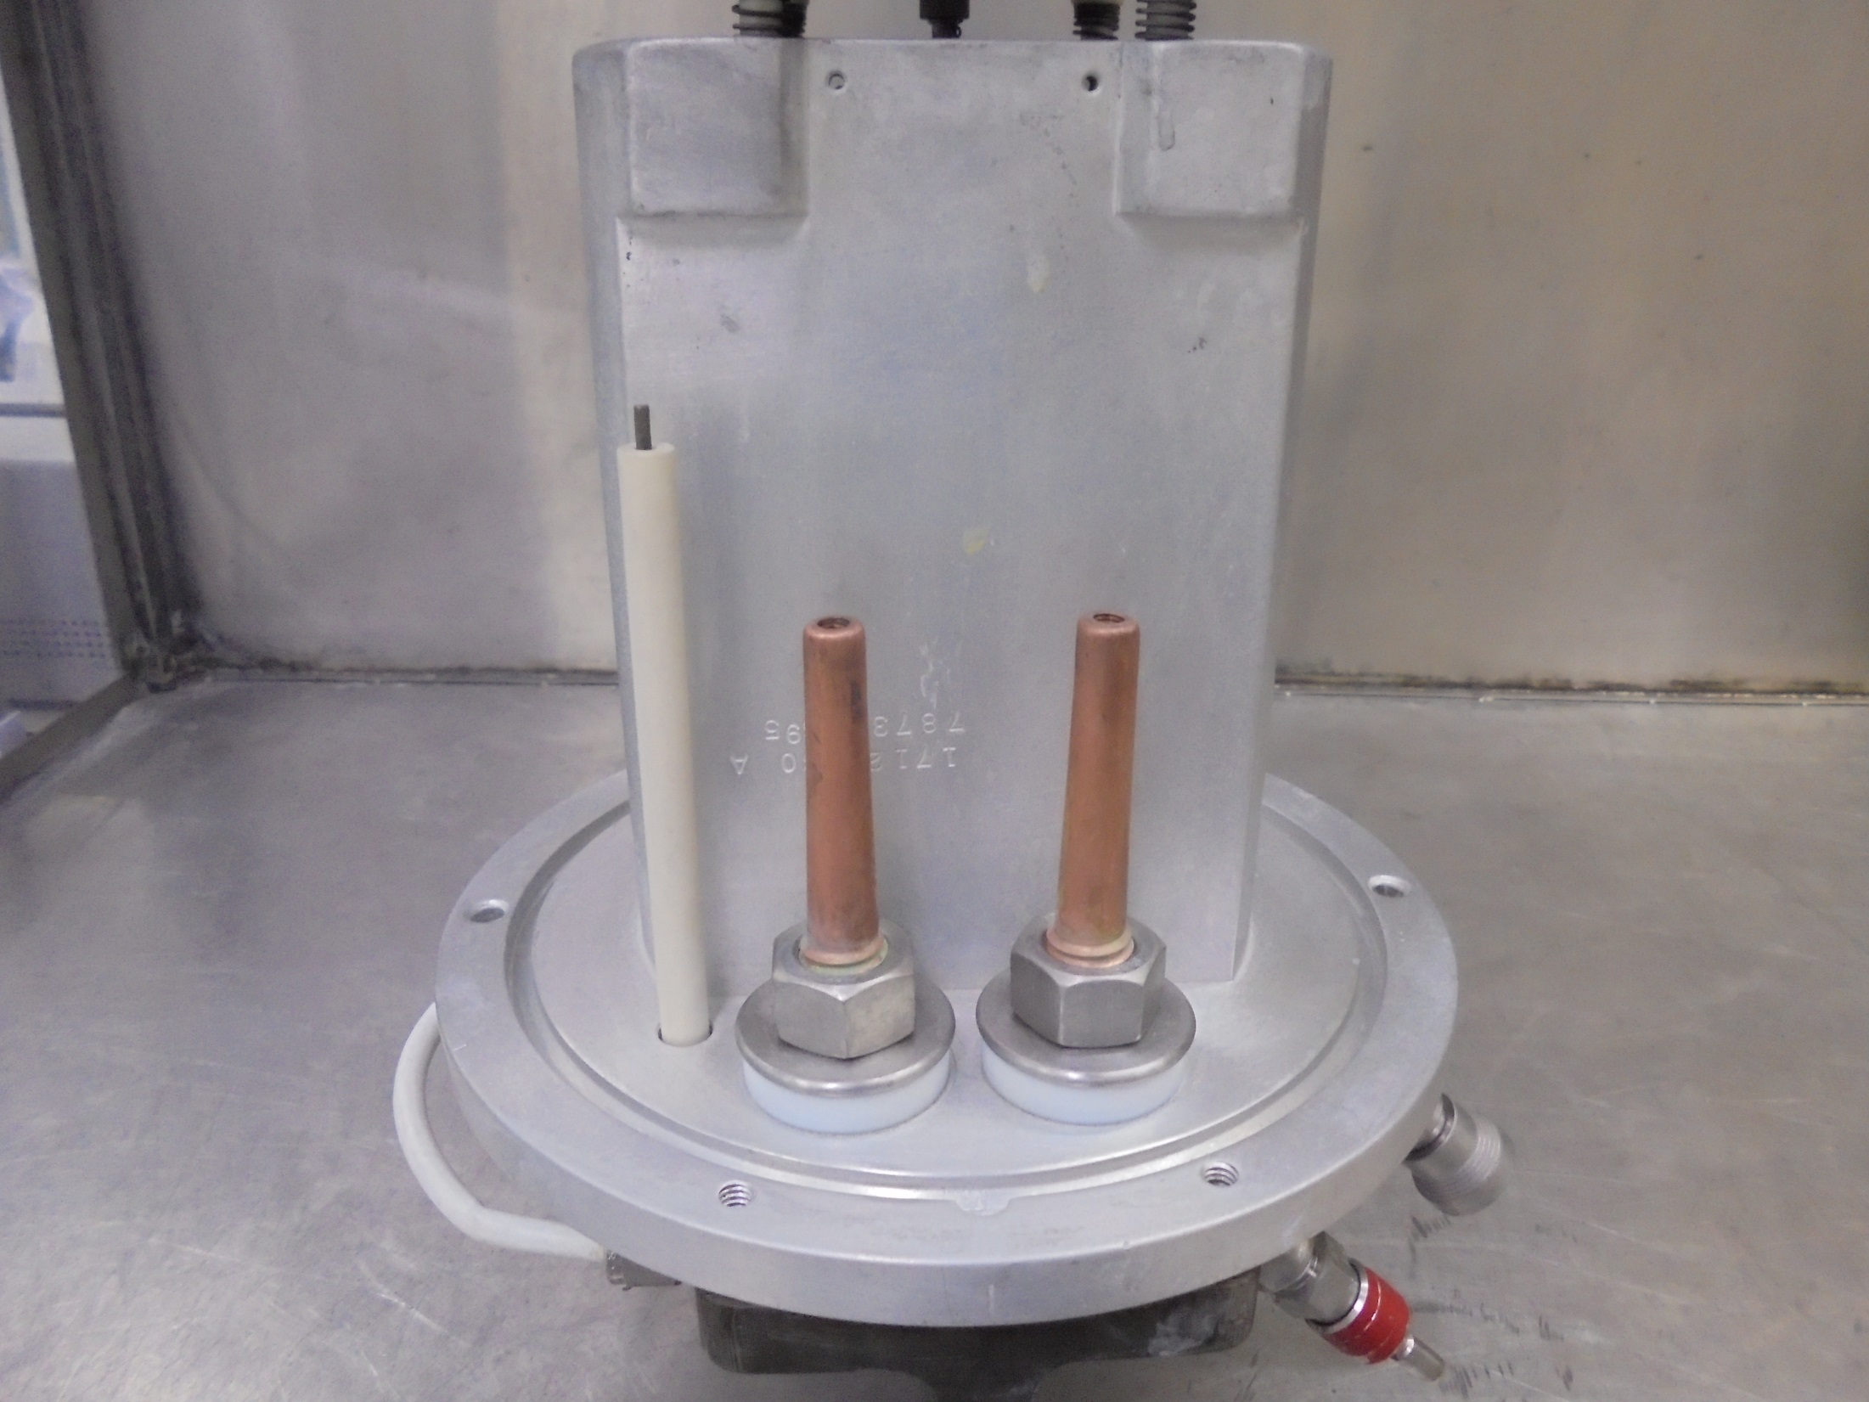
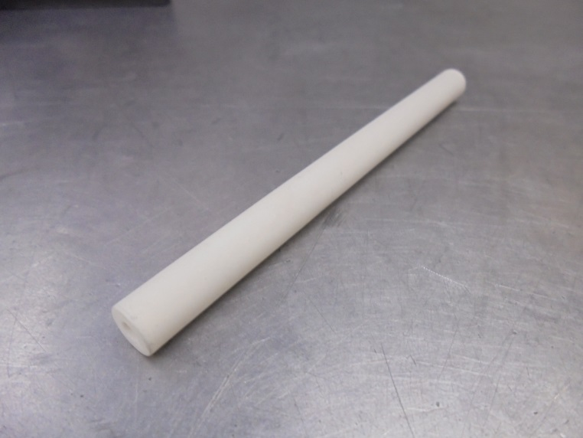
Install…
CATHODE FEEDTHRU INSULATOR

Slide 16
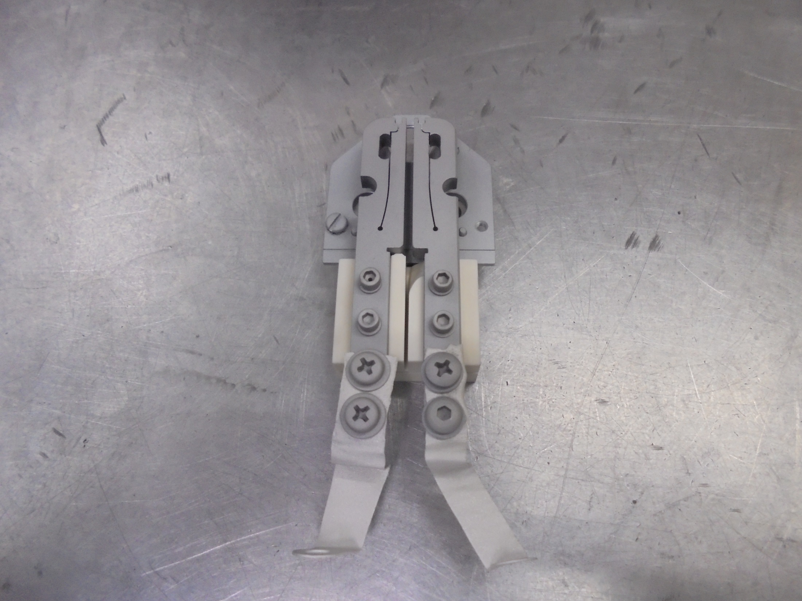
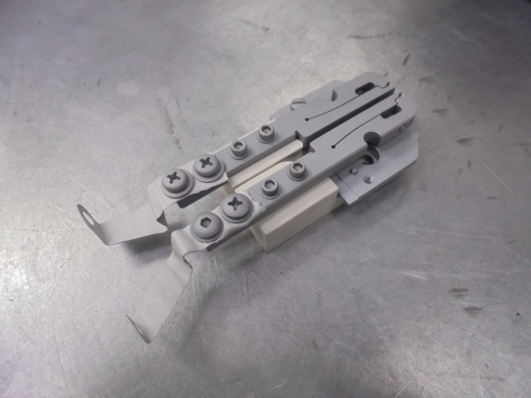
FILAMENT CLAMP
CATHODE SUPPORT
PLATE
INSULATOR MOUNTING
BLOCK
FILAMENT STRAP

Slide 17
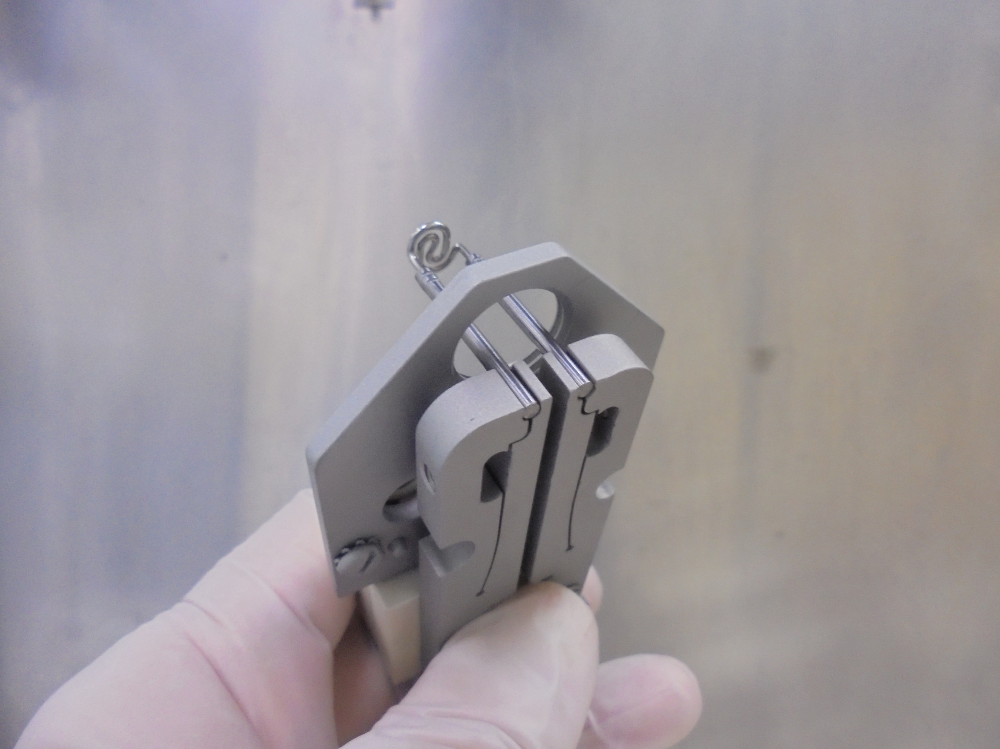
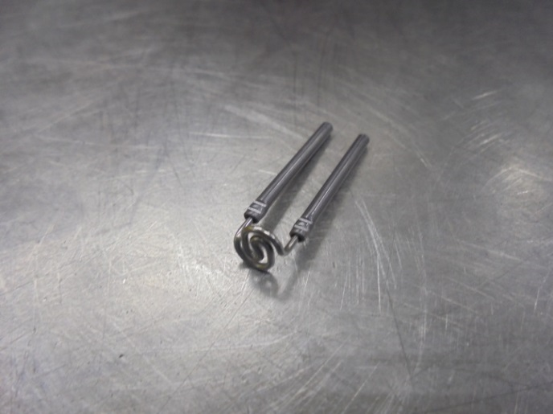
ELS FILAMENT
*Install The Filament

Slide 18
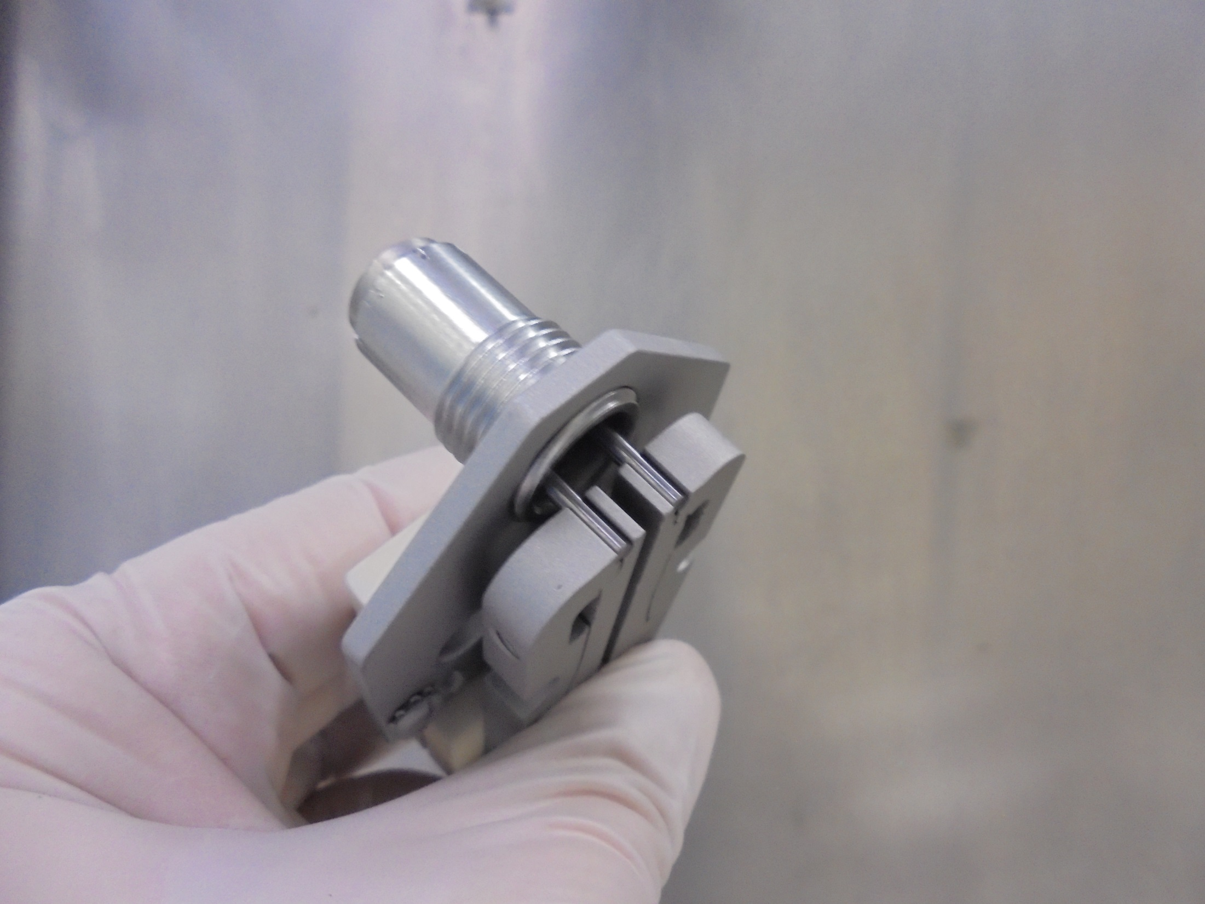
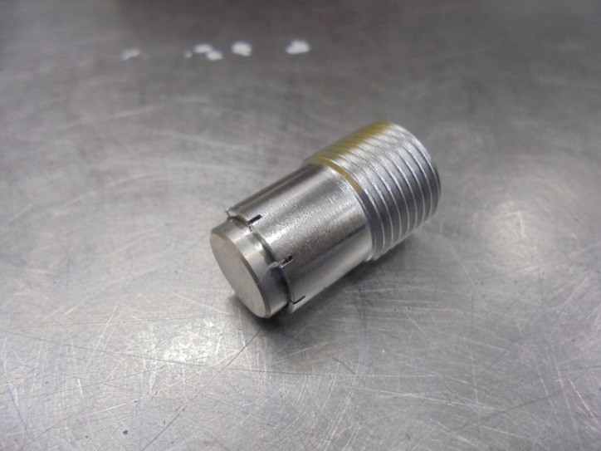
CATHODE
*Install Cathode

Slide 19
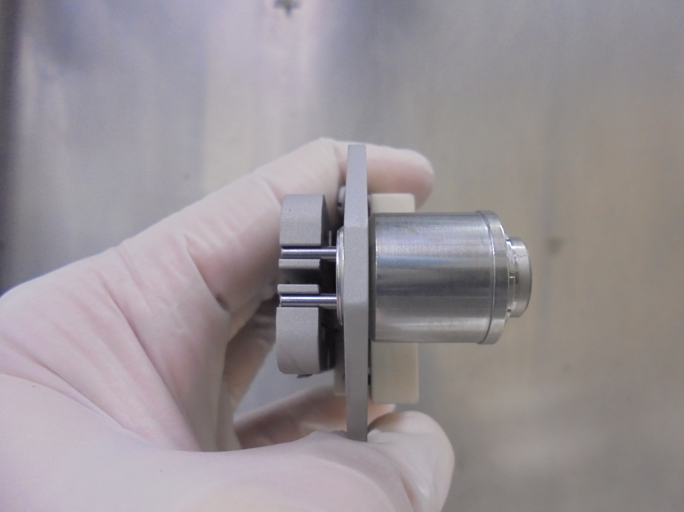
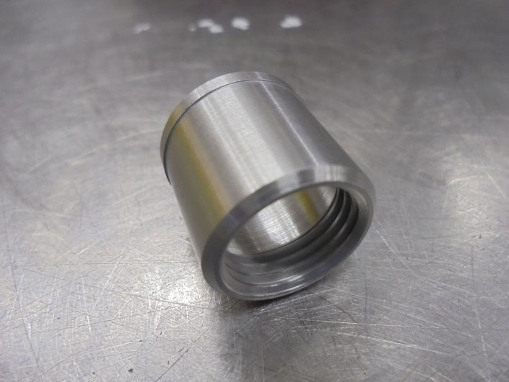
CATHODE REPELLER
*Install Cathode Repeller

Slide 20
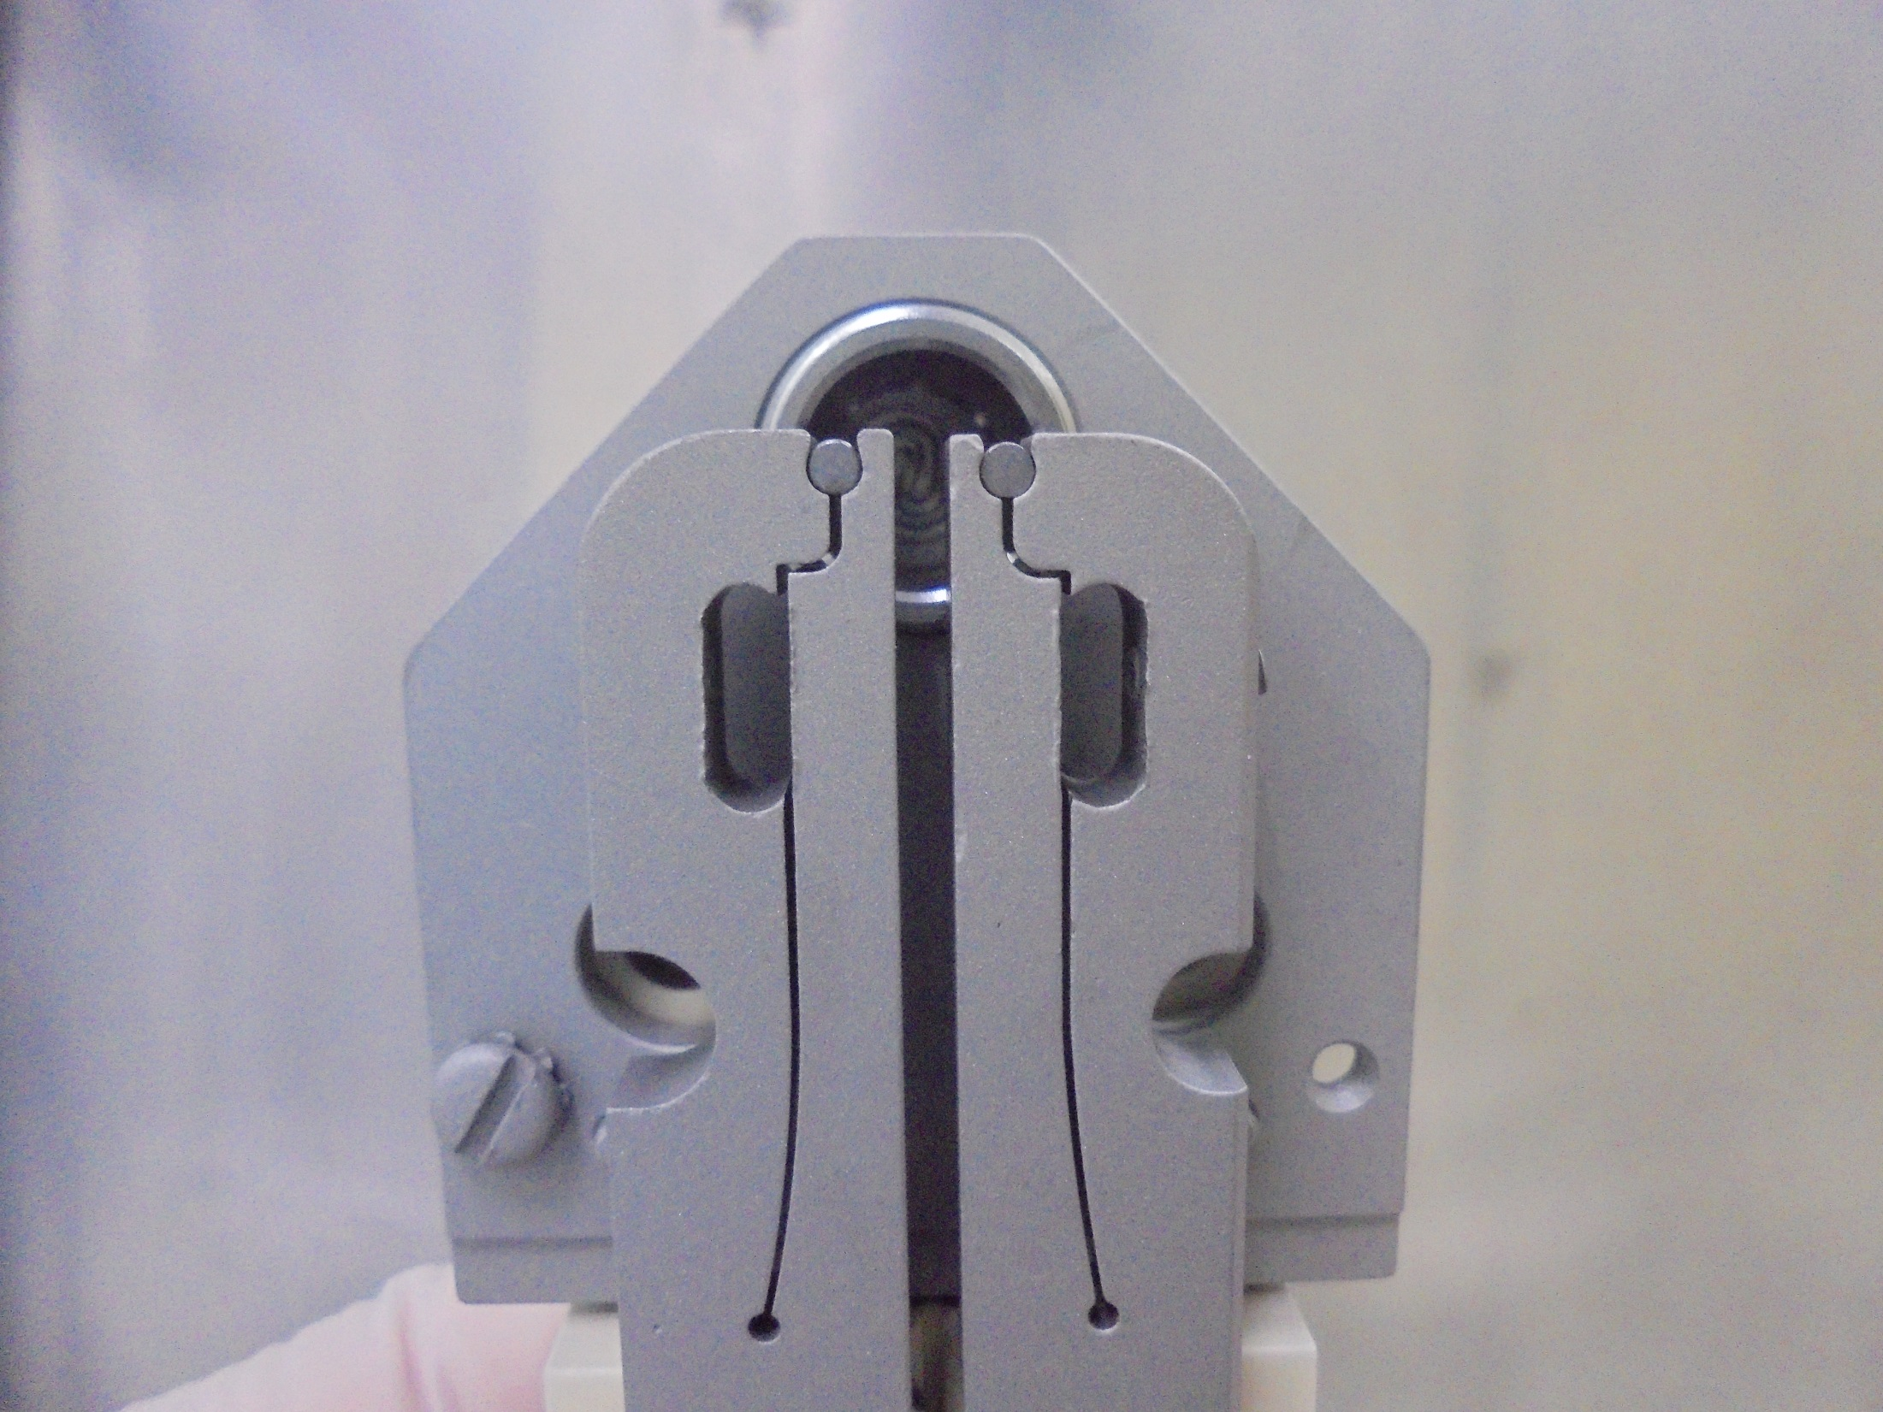
*Make Sure FILAMENT Is Properly
Mounted On FILAMENT CLAMP

Slide 21
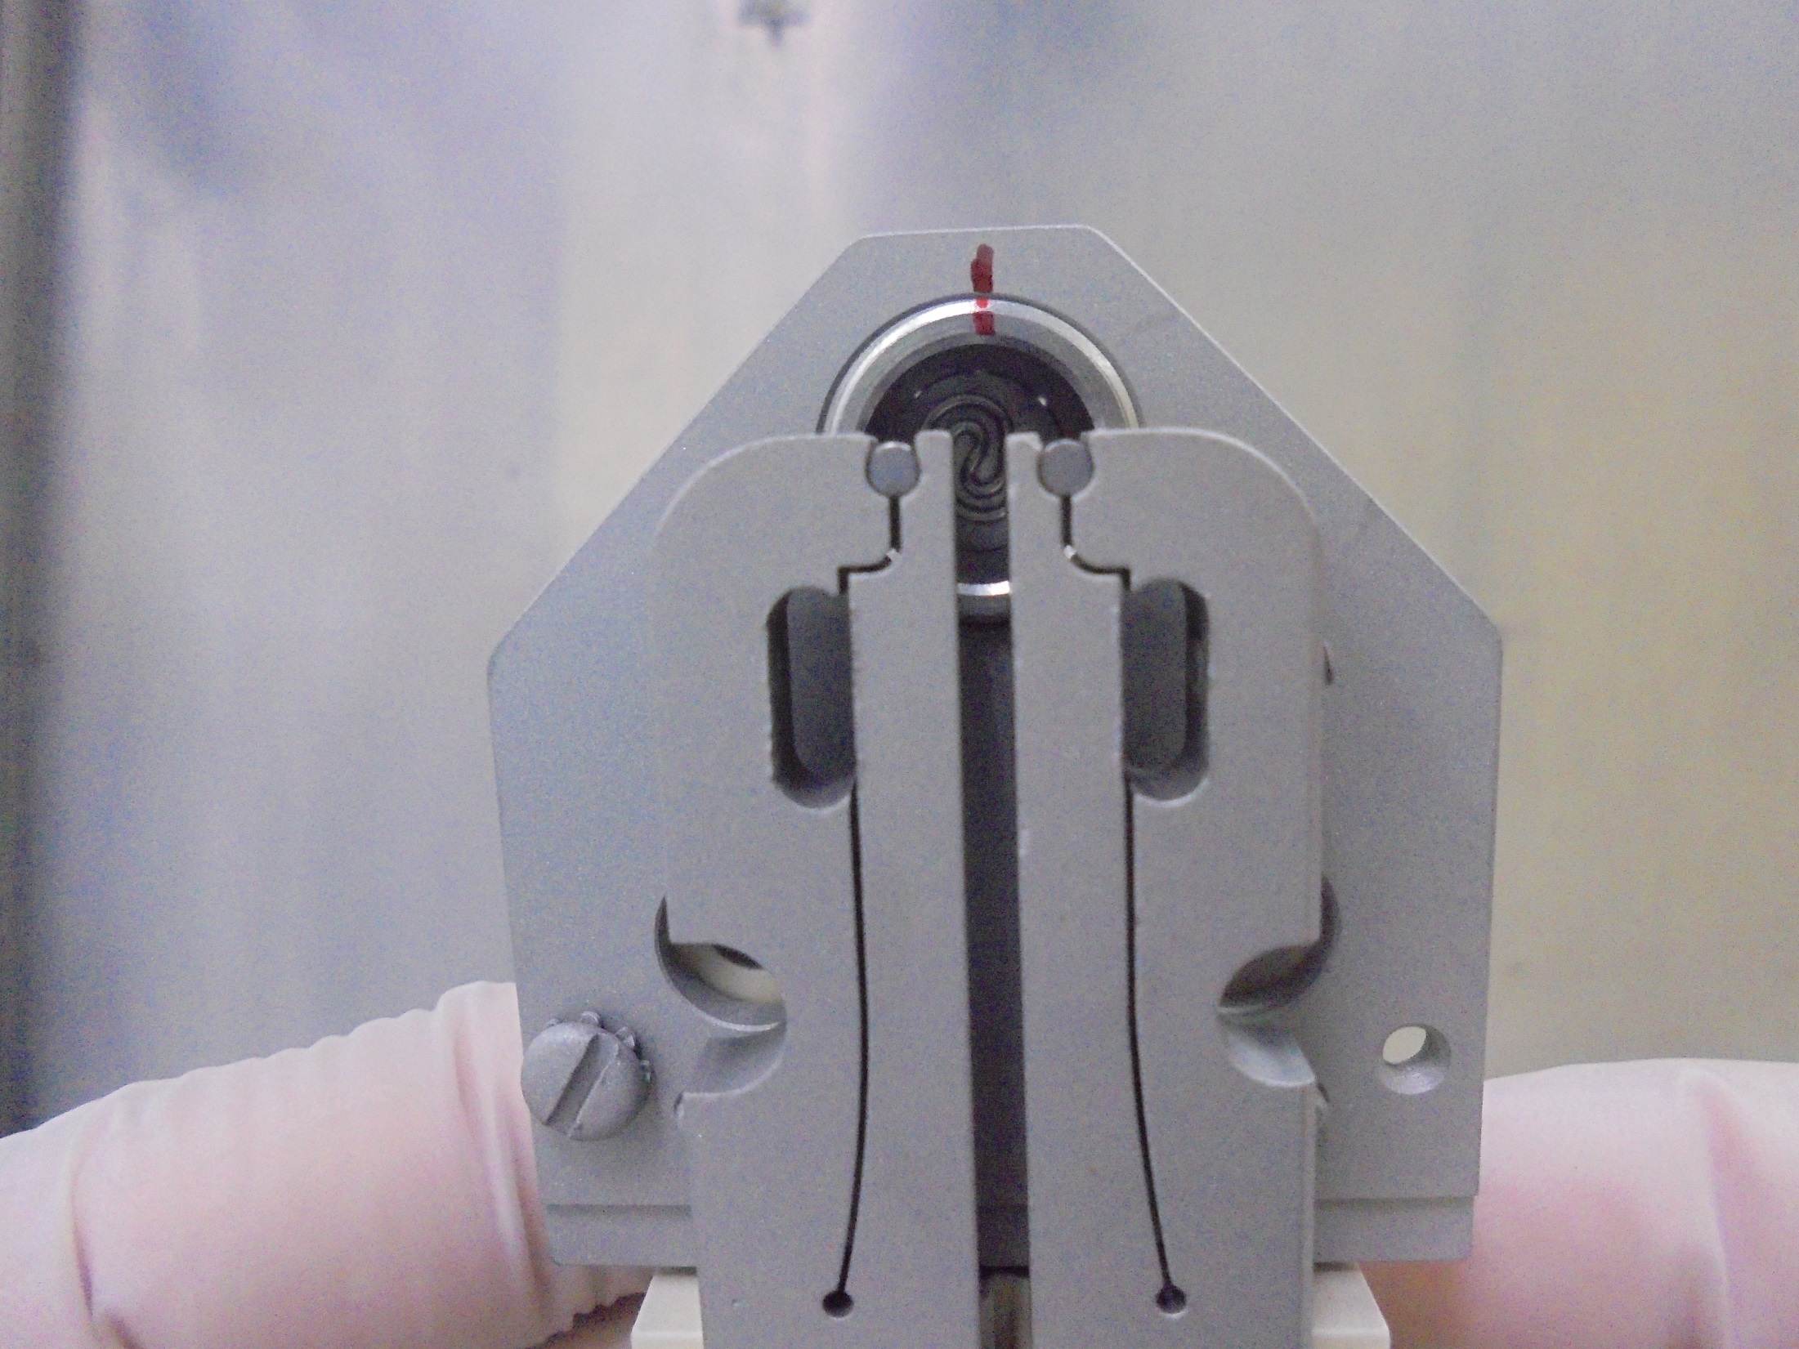
*Mark and Rotate Clockwise The CATHODE
[ FILAMENT and CATHODE Distant Alignment ]

Slide 22
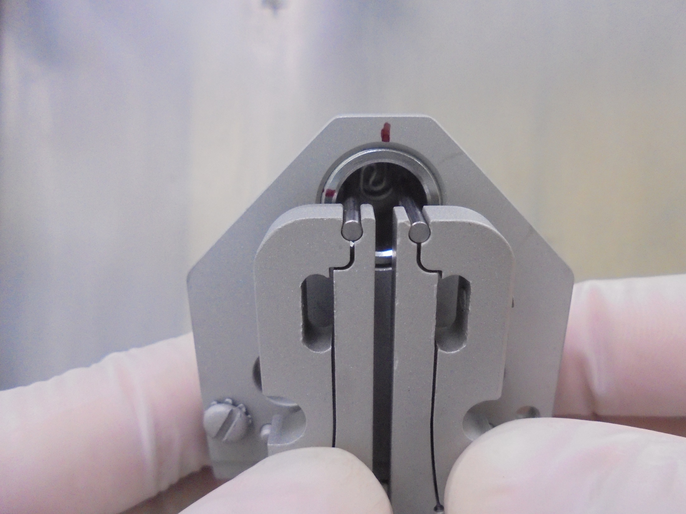
Alignment Point
* CATHODE Rotated In The Alignment Point

Slide 23
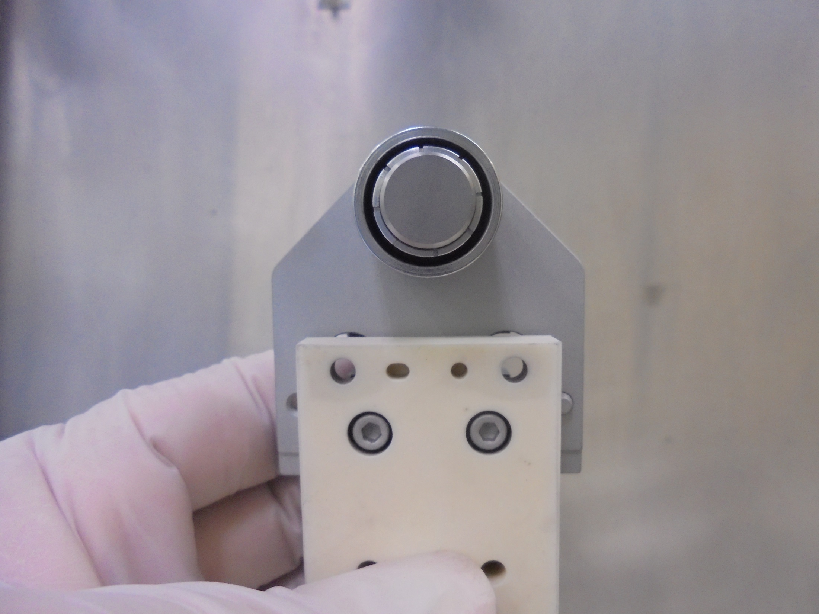
*Carefully Align and Tighten
The CATHODE REPELLER On
CATHODE SUPPORT PLATE

Slide 24
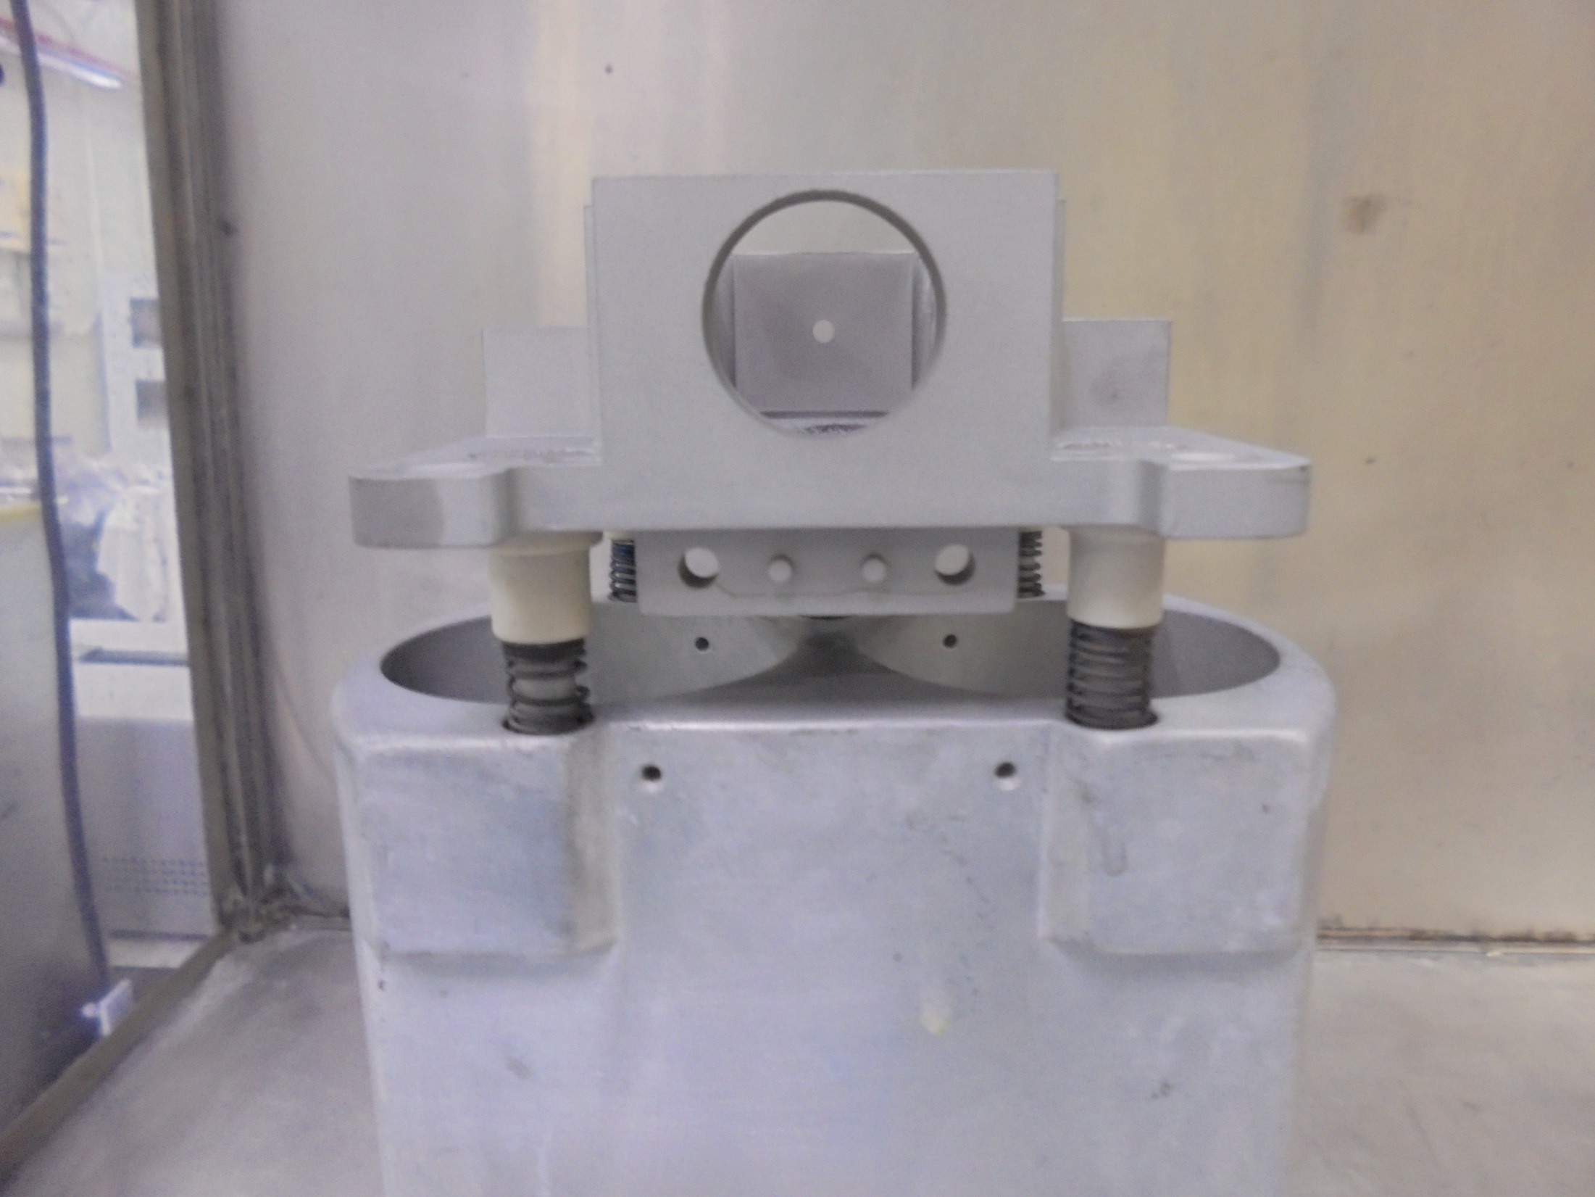
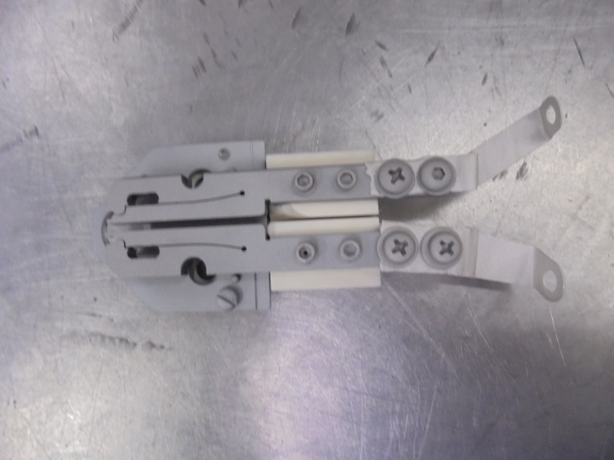
*Install Filament Parts
On ARC CHAMBER…

Slide 25
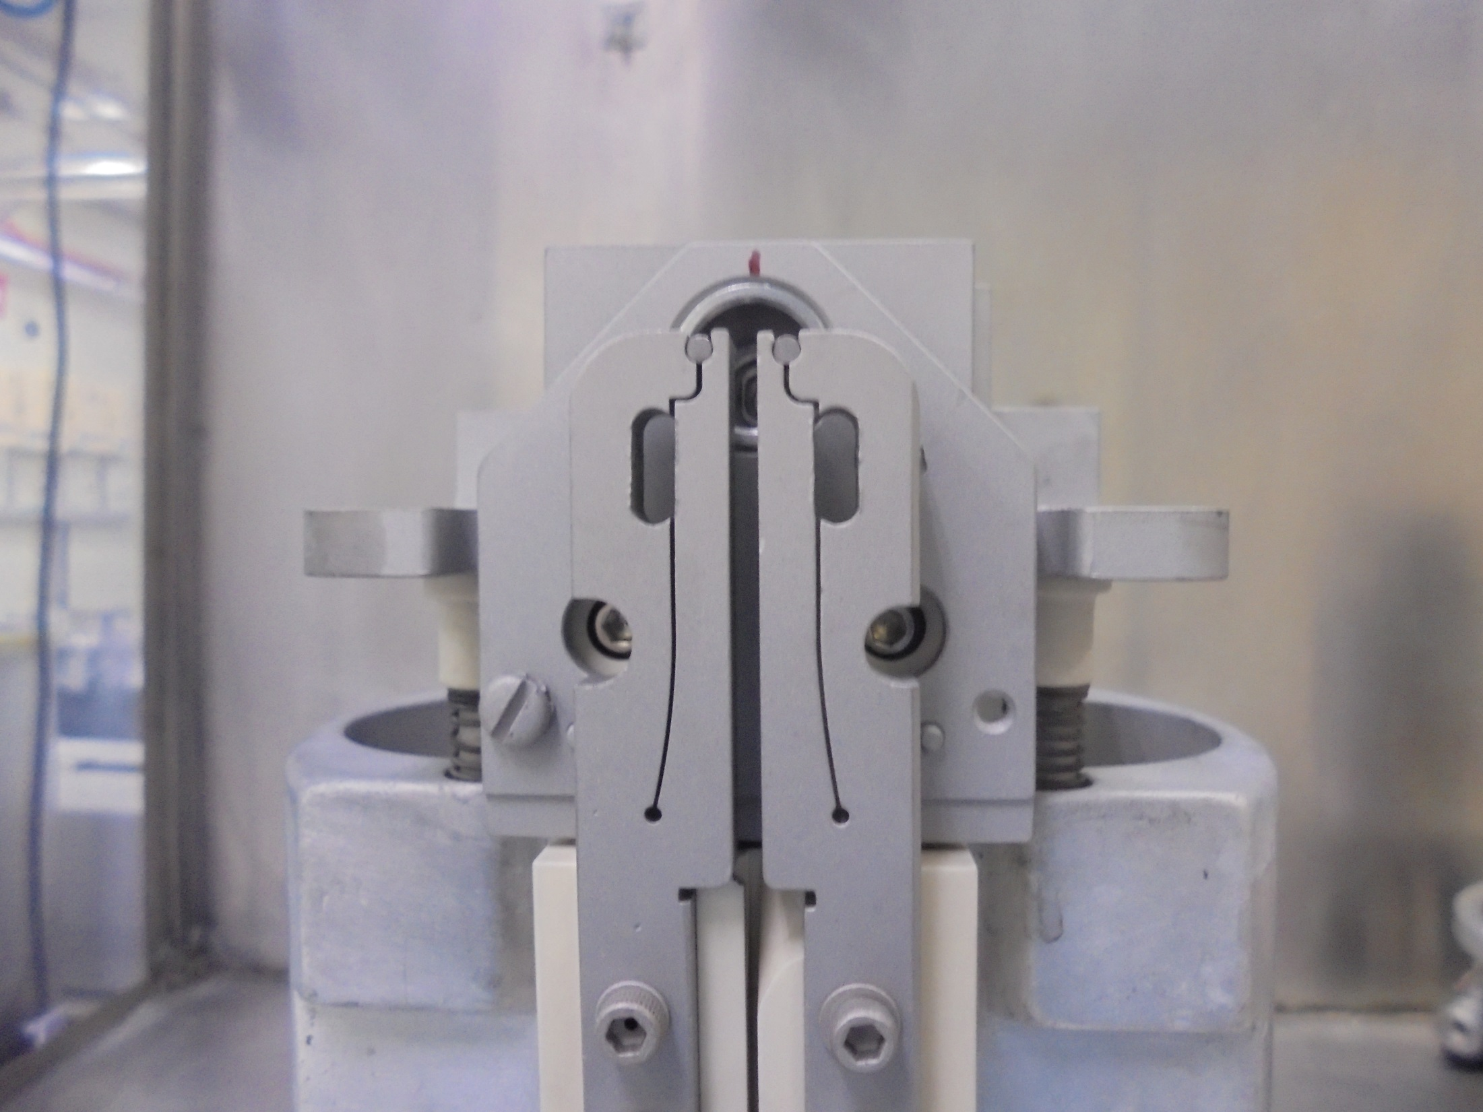
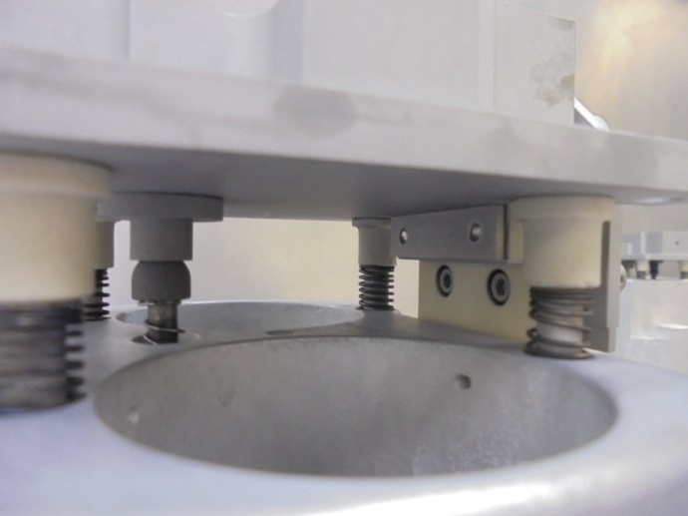
*Secure The Screws

Slide 26
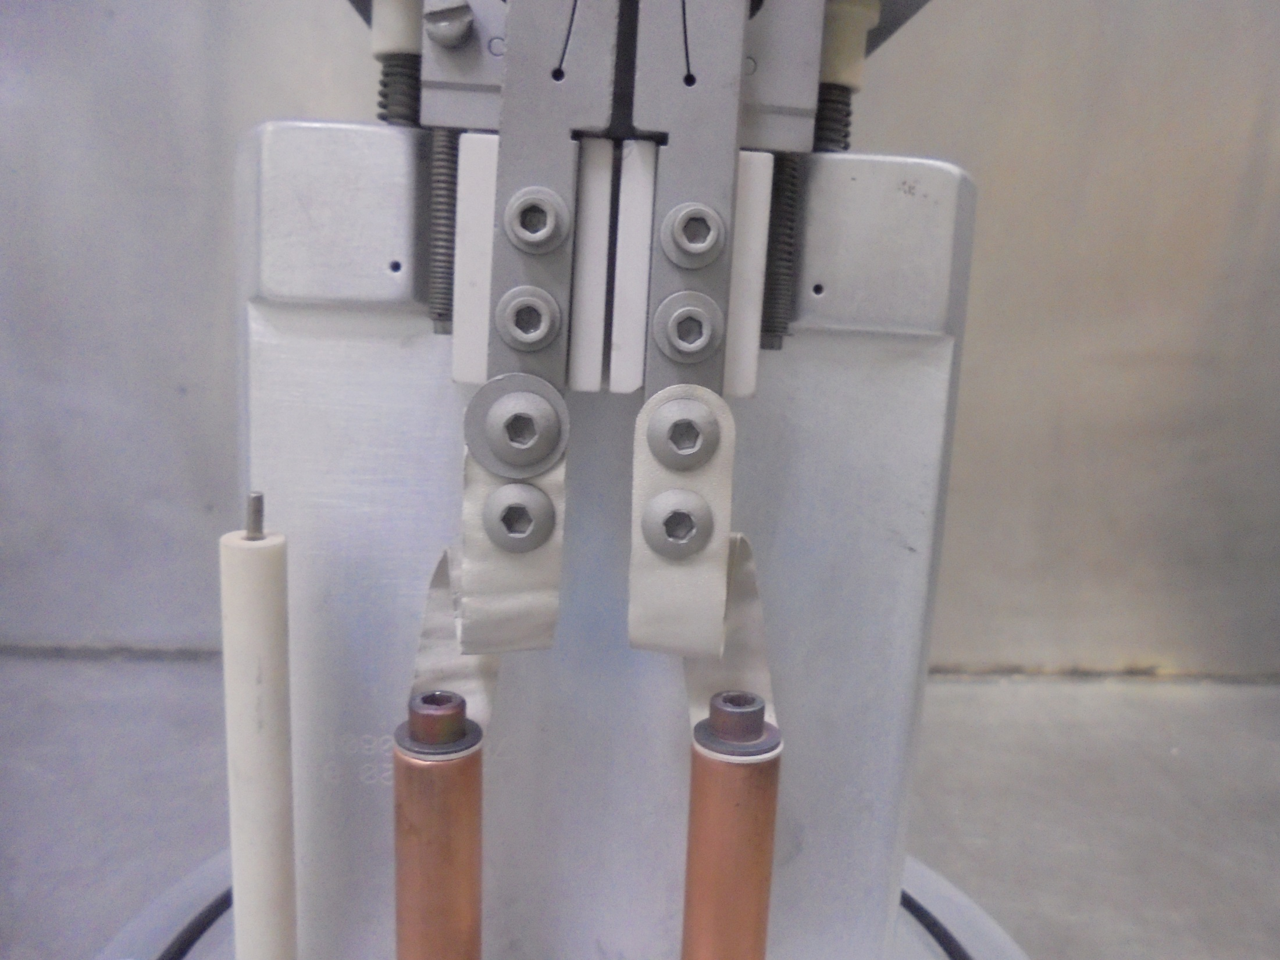
Tightly Secure All Screws On This Part

Slide 27
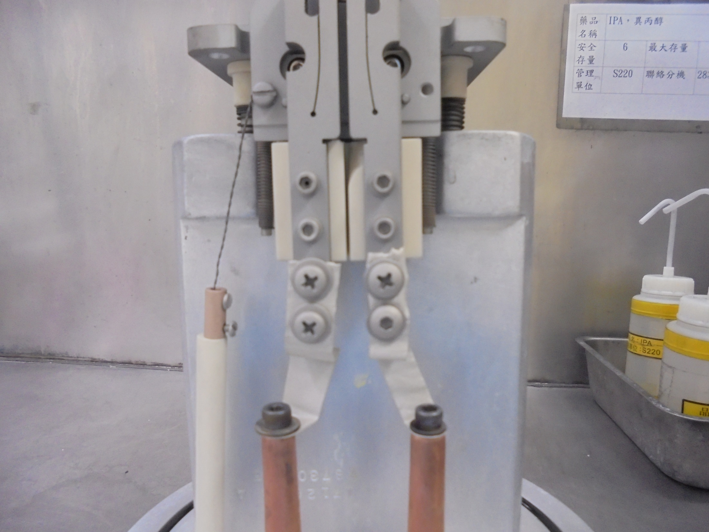
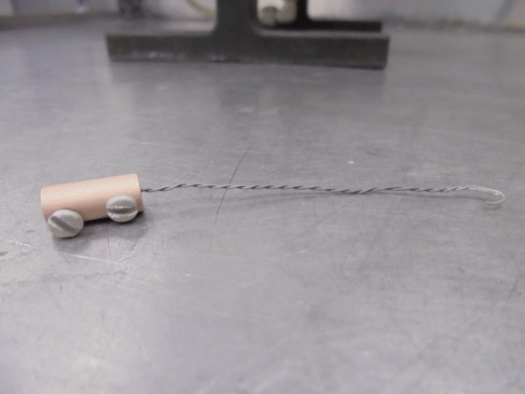
Install CATHODE WIRE…

Slide 28
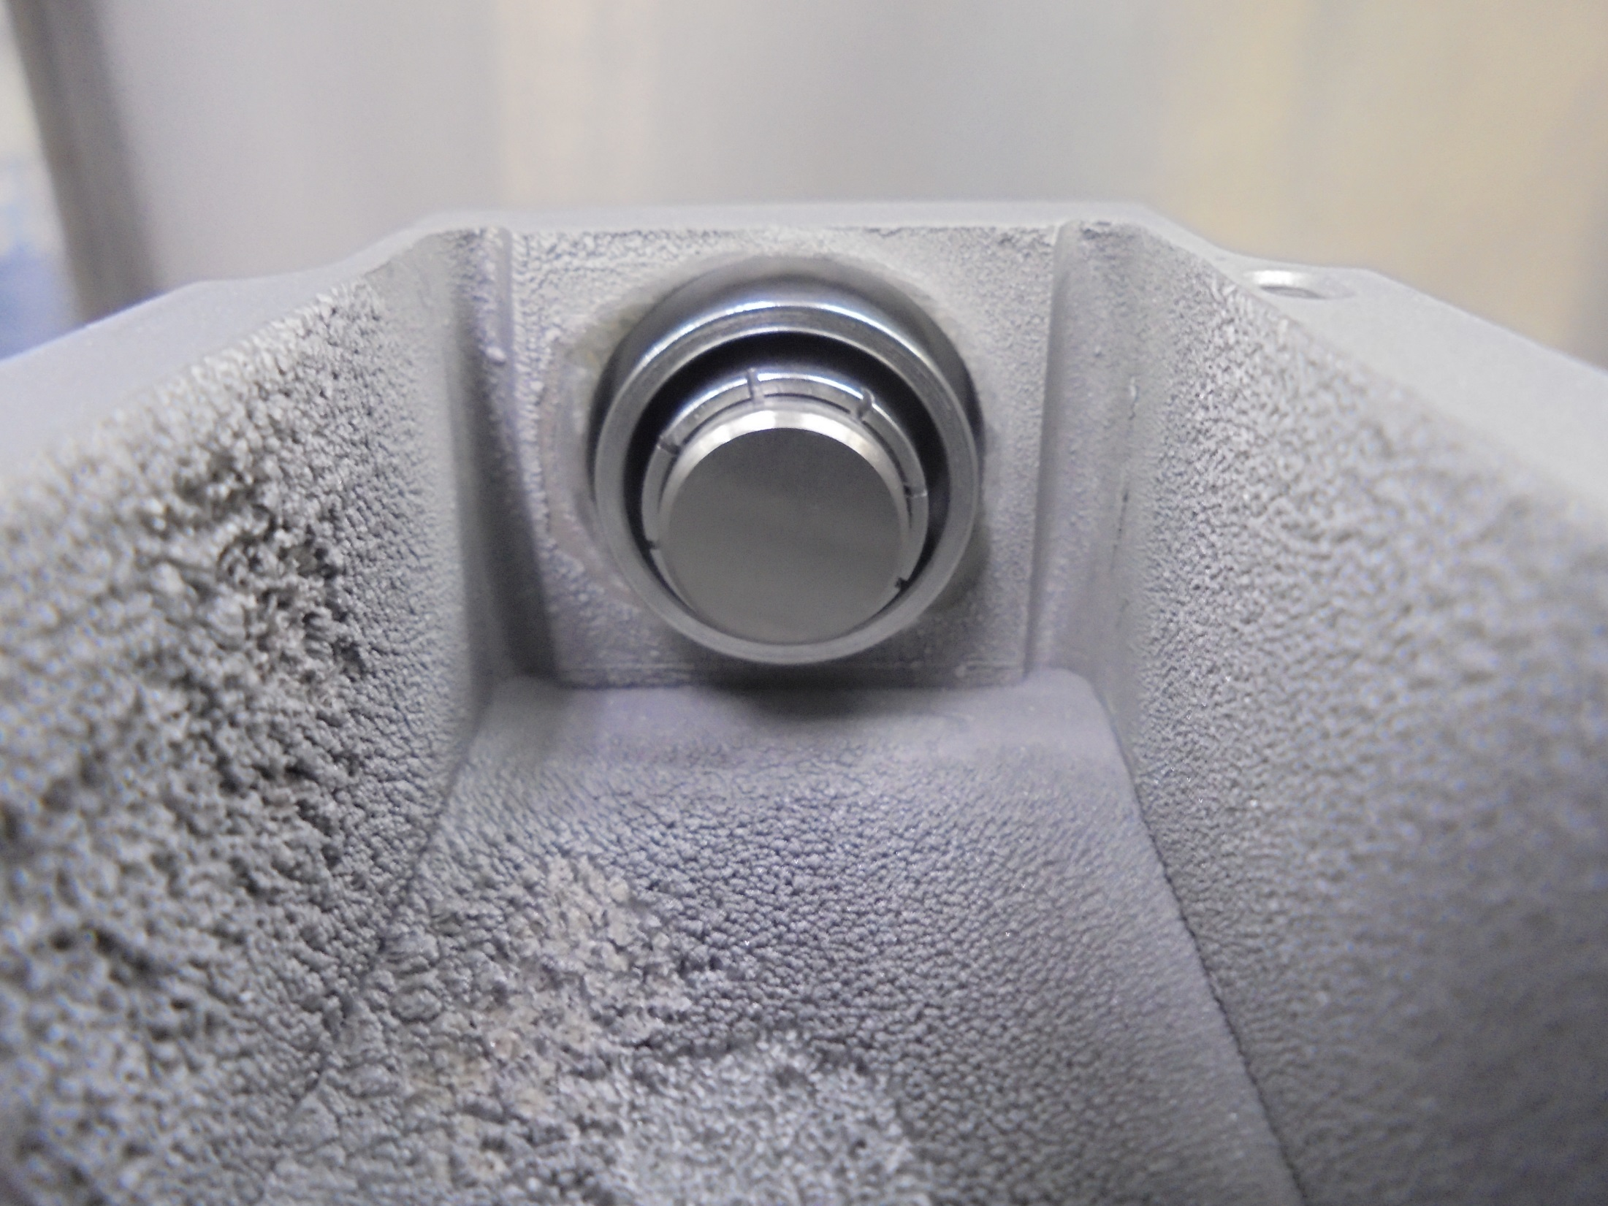
*Make Sure CATHODE Is Evenly Align.
It Must NOT Touch On ARC CHAMBER Wall

Slide 29
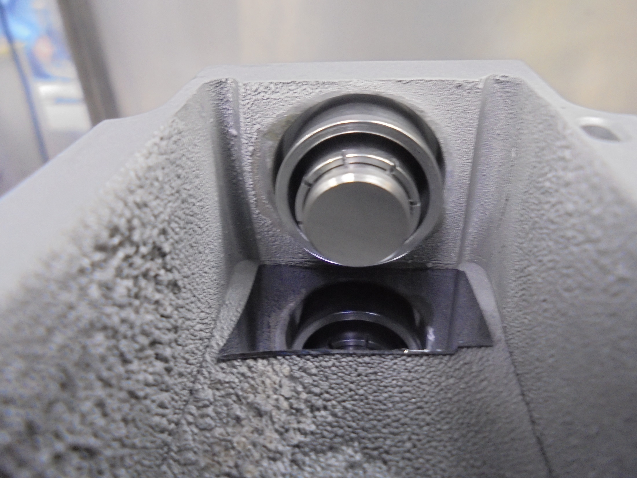
*Use Mirror For Visual Alignment Guide…

Slide 30
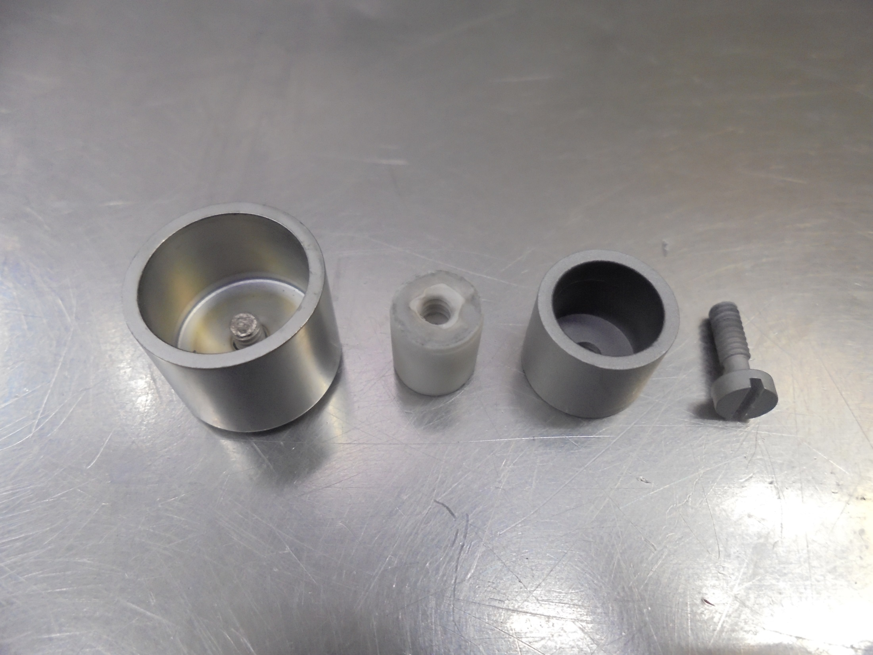
REPELLER COMPONENTS
INSULATOR STAND-OFF
REPELLER SCREW
INNER CUP SHIELD
ELS REPELLER

Slide 31
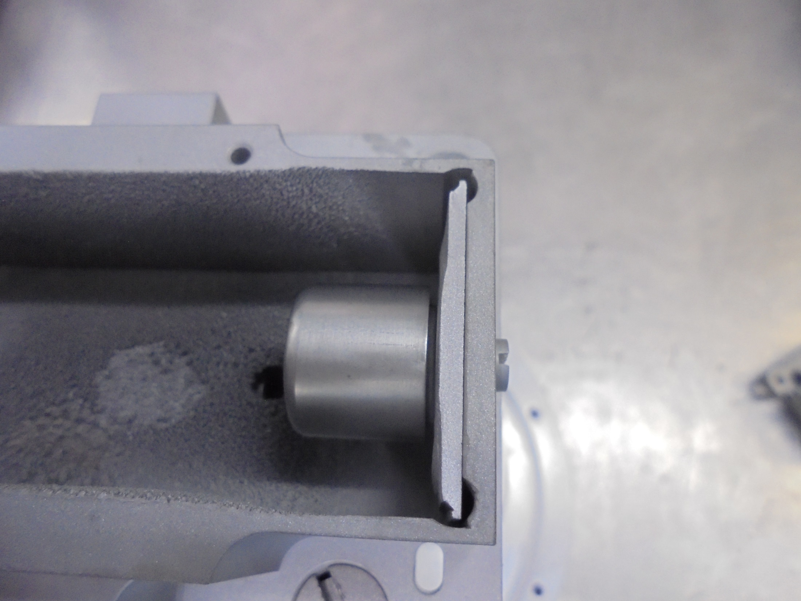
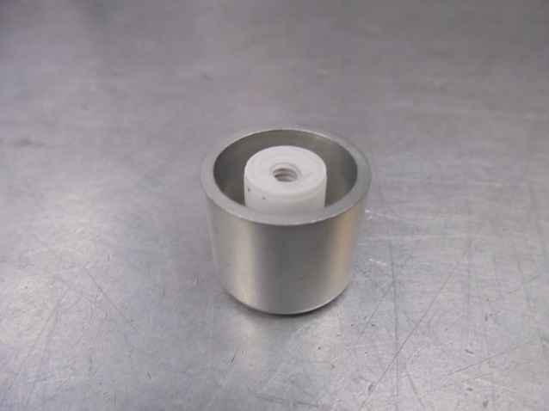
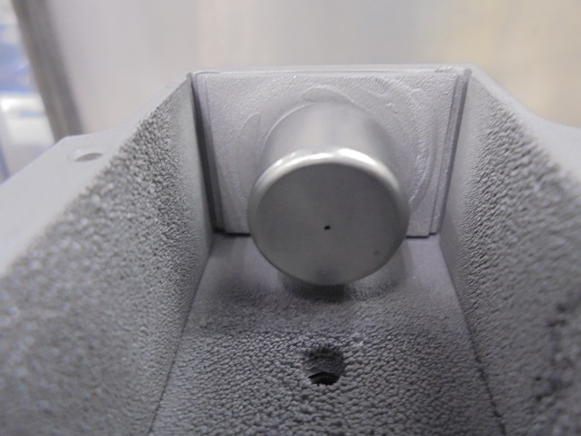
Install / Set…

Slide 32
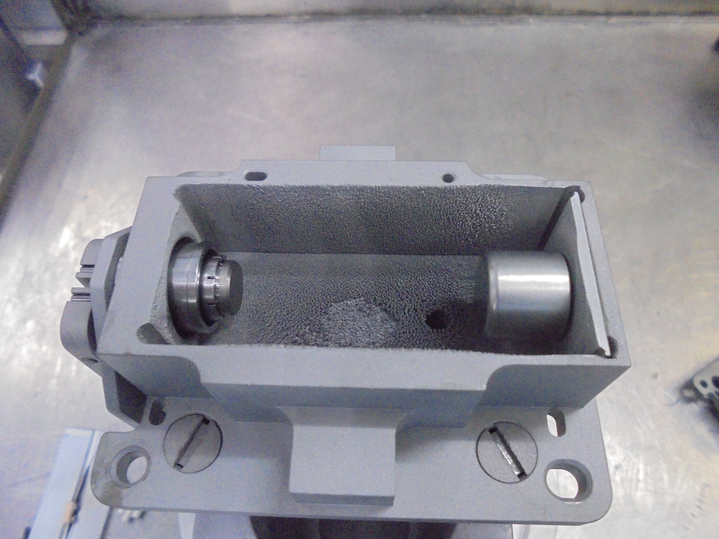
FILAMENT END
REPELLER END

Slide 33
ISOLATION TEST

Slide 34
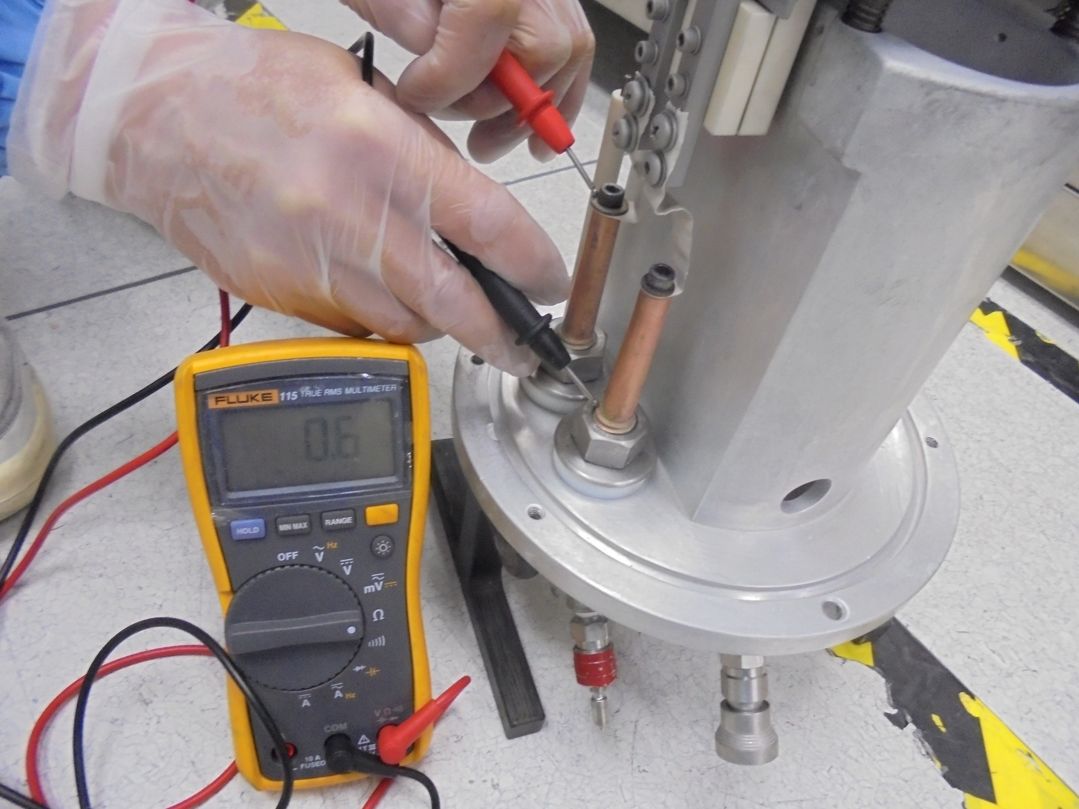
FILAMENT to FILAMENT

Slide 35
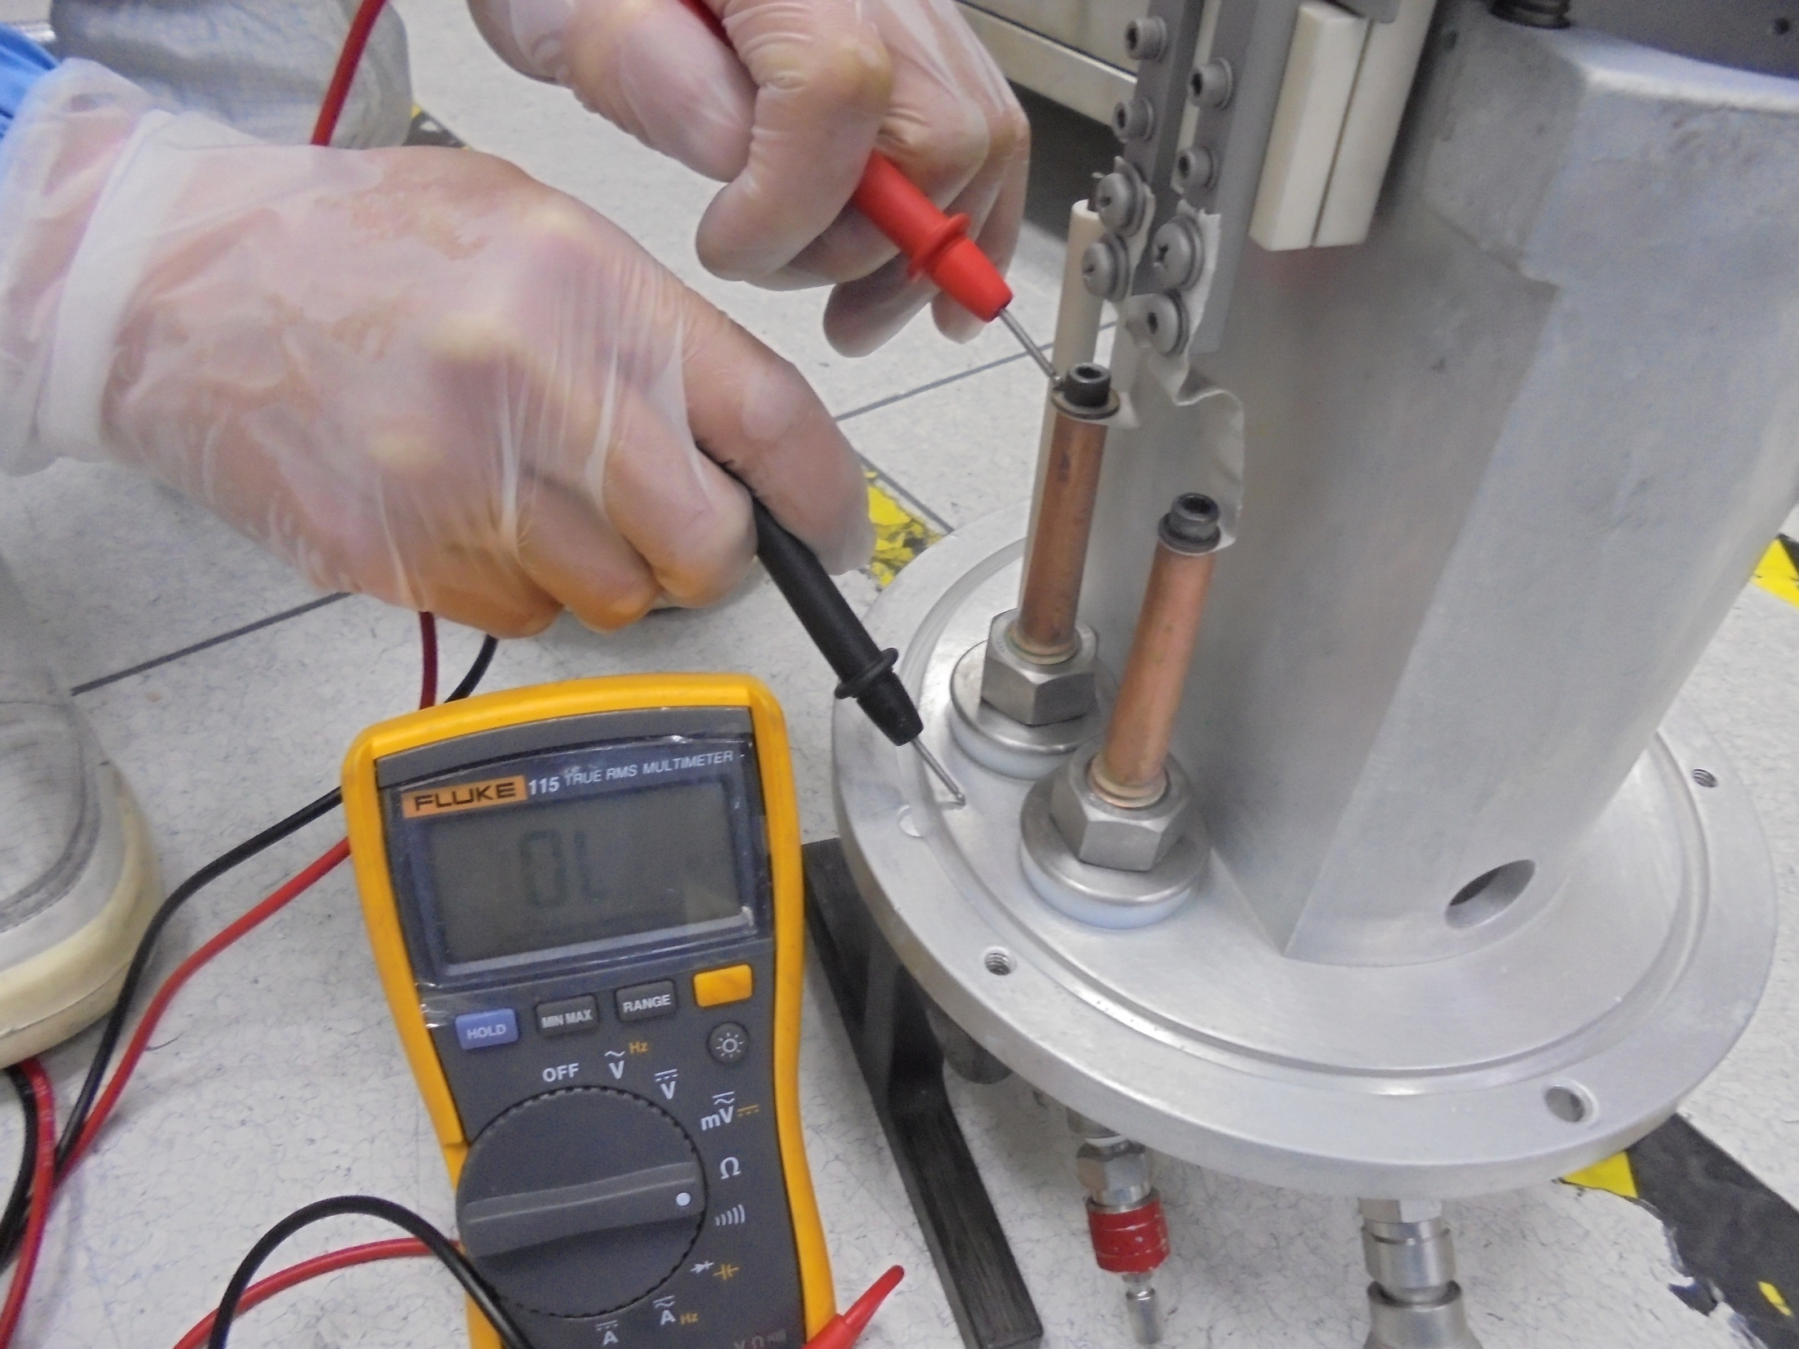
FILAMENT to SOURCE BODY

Slide 36
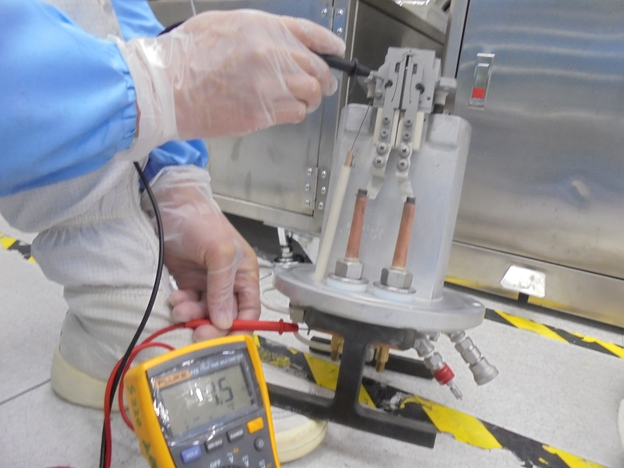
FEED-THRU CATHODE to
CATHODE SUPPORT PLATE

Slide 37
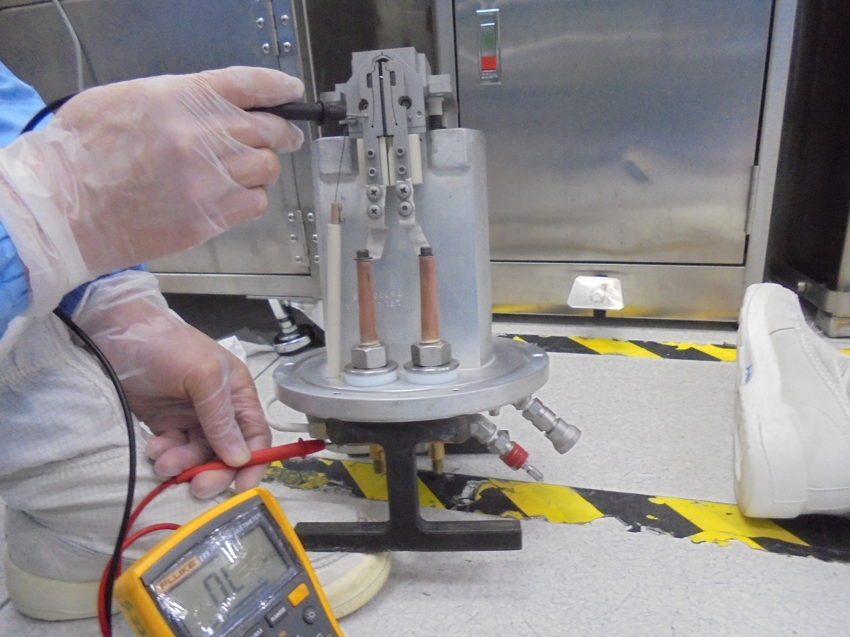
FILAMENT CLAMP to
FEED-THRU CATHODE

Slide 38
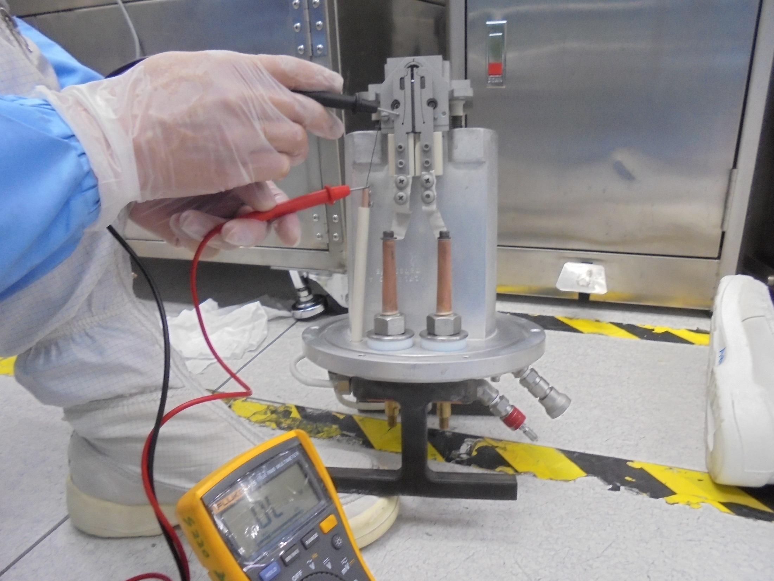
FILAMENT CLAMP to
CATHODE WIRE

Slide 39
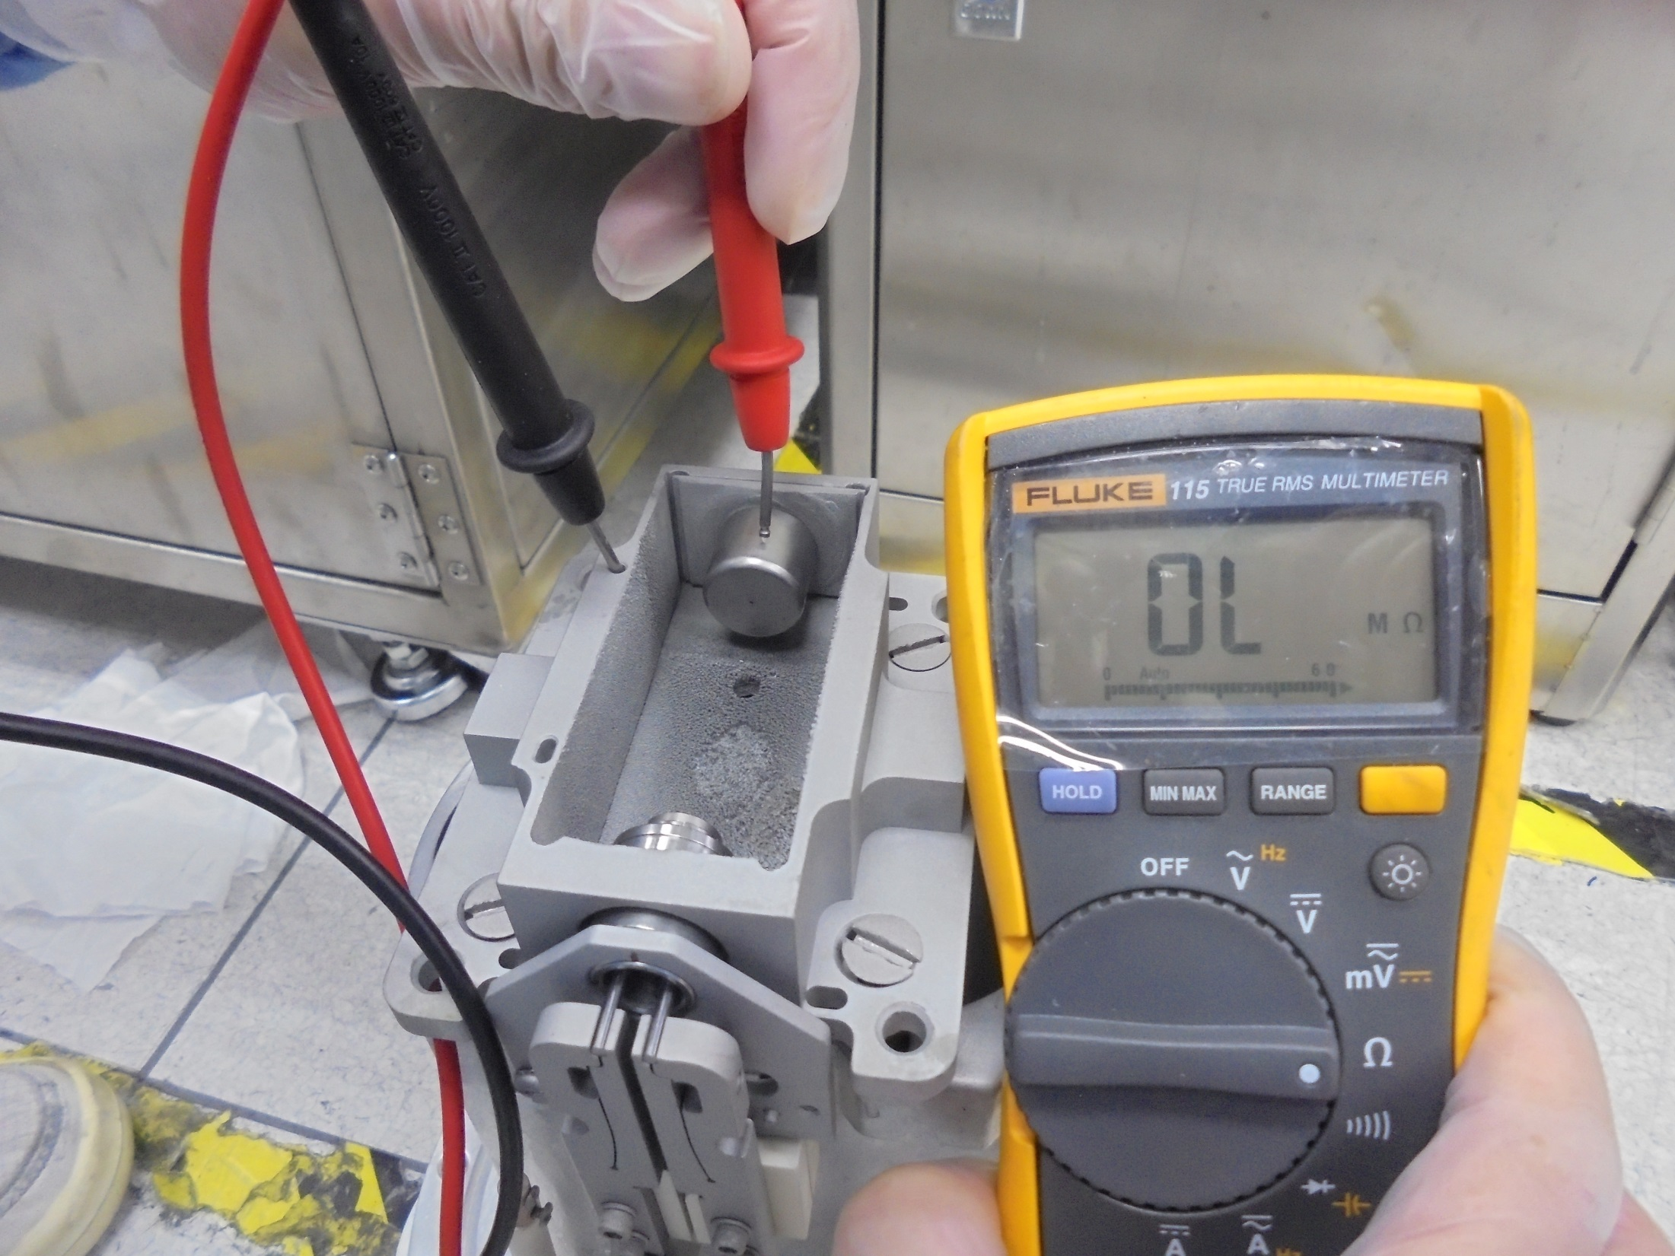
ARC CHAMBER to
REPELLER

Slide 40
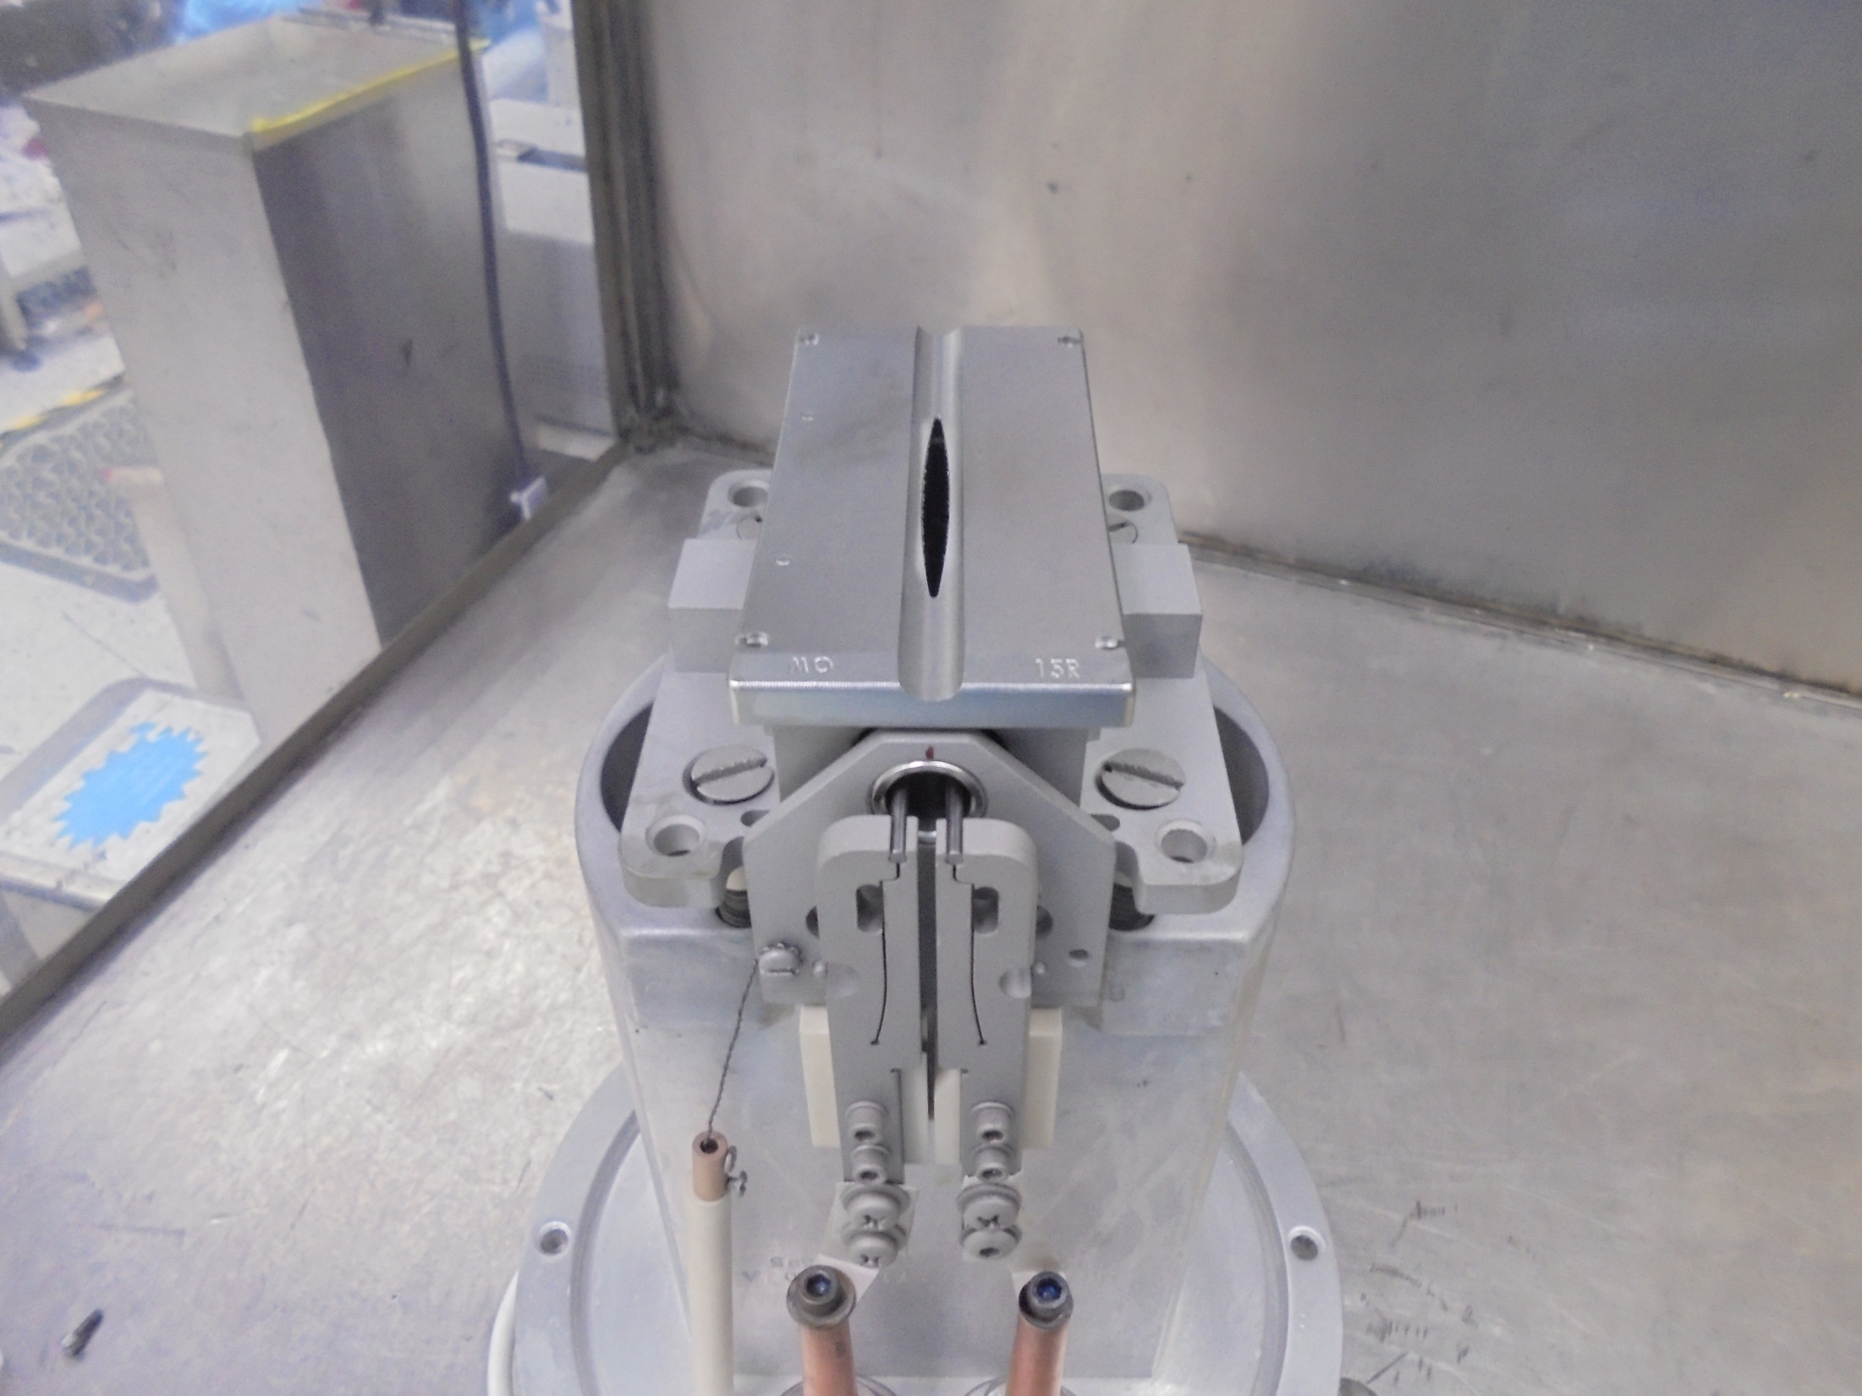
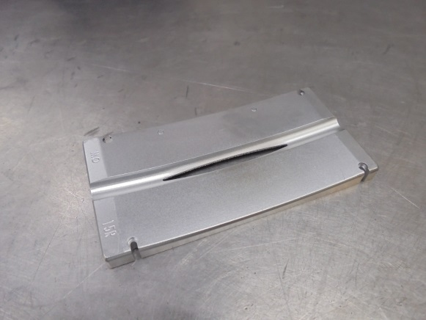
FACE PLATE 15R

Slide 41
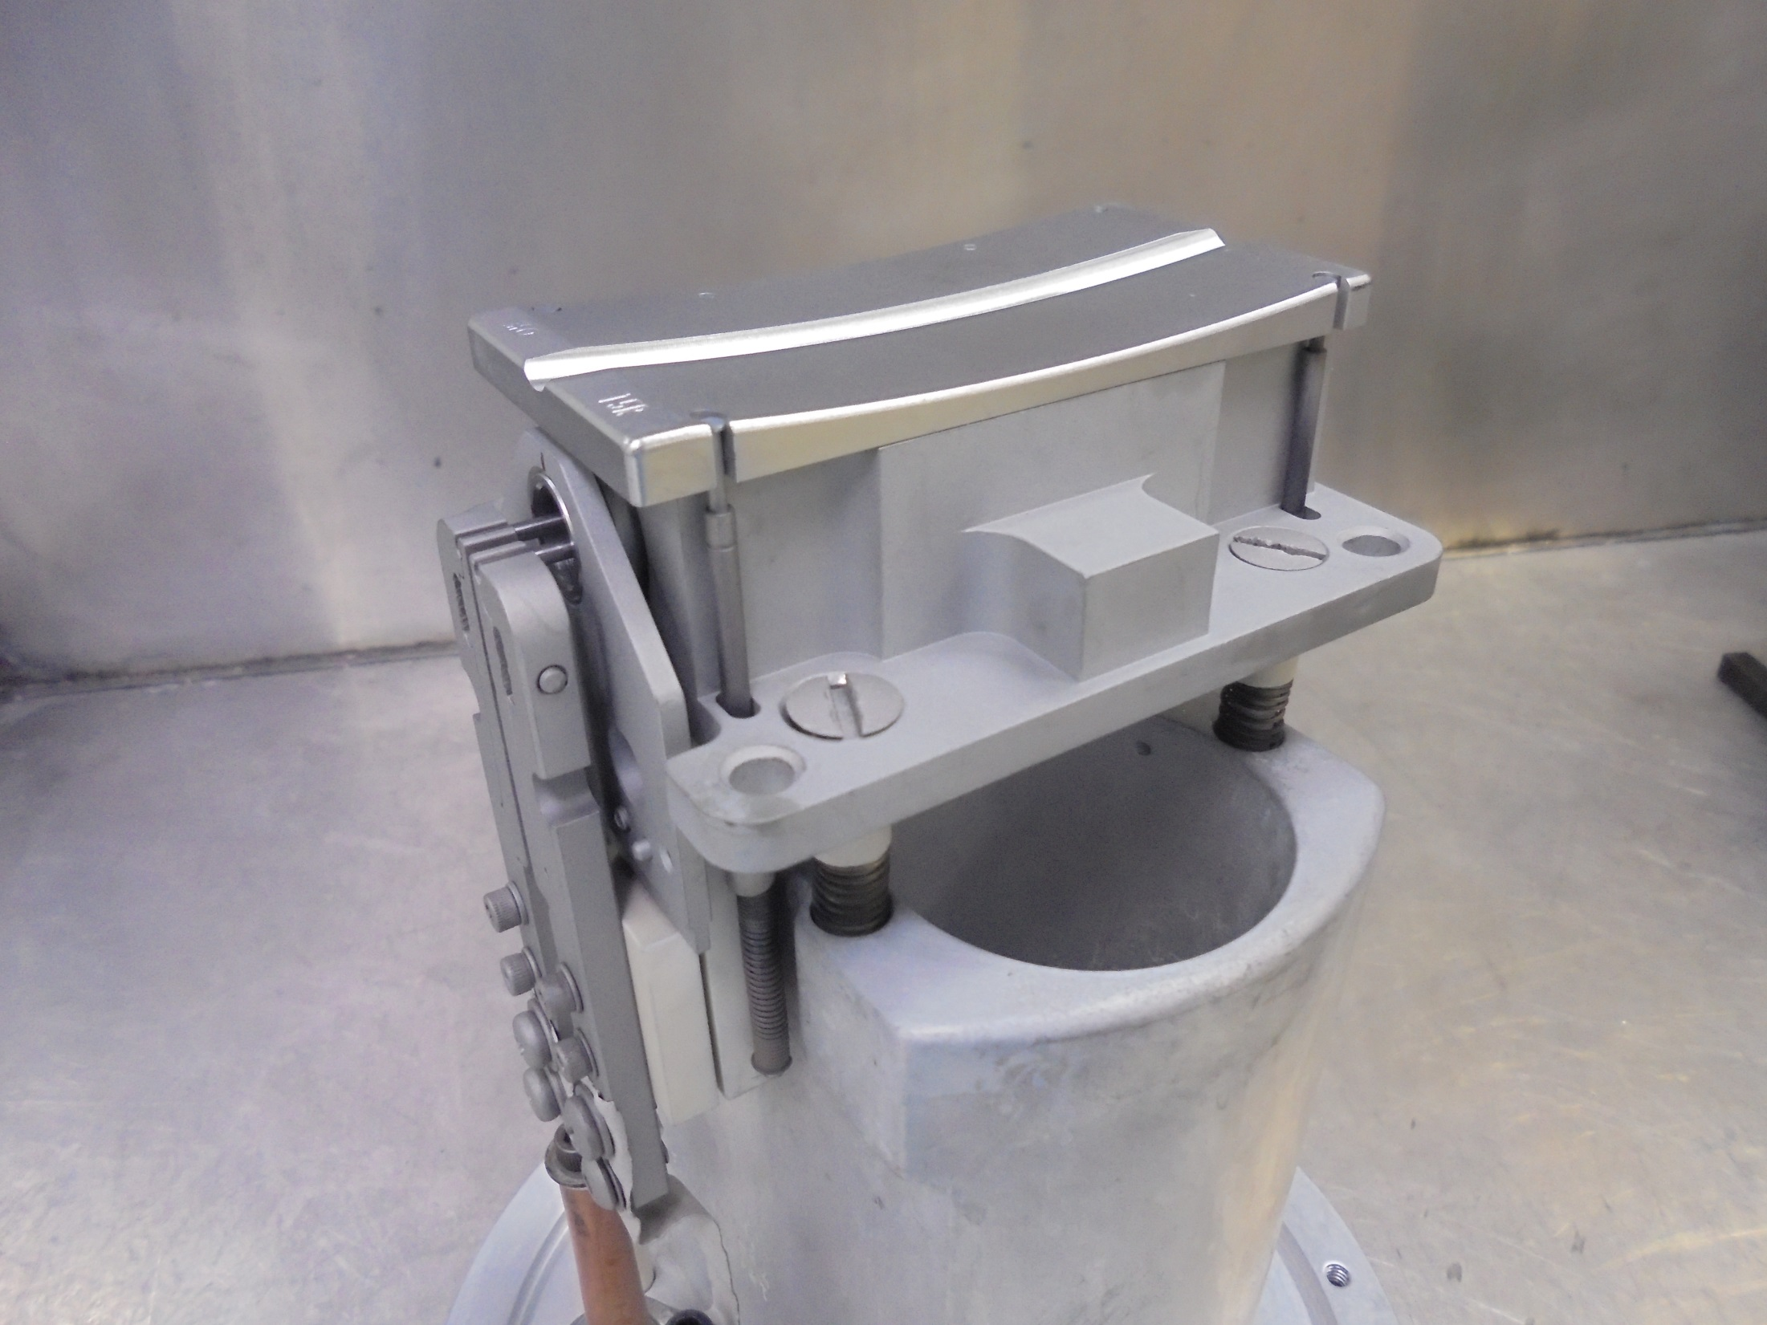

Install The RETAINER PINS

Slide 42

*Clean The O-RING Slot

Slide 43


*Clean /Check The O-RING and Install

Slide 44

Sign NAME and DATE
Maintenance Done.

Slide 45
-END-

